Slide 1
APV Accommodation and more!
Account
Log-in

Slide 2
Your personal APV portal
This guide will explain how to access and utilize your personal APV portal.
This guide is suitable for new tenants trying to reserve their first accommodation with us.
This guide is also suitable for current tenants, who already are living in an APV location.

Slide 3
Index
What is the APV portal?
How to sign your contract in the APV portal?
How to pay your rent an deposit.

Slide 4
What is APV portal?
The APV Portal is a digital environment that facilitates the communication between APV and tenants.
Here you are able to access functions easier; signing your contract, paying your rent, reporting a malfunction and many others!

Slide 5
Step 1: Login
You will receive your username and password by email. The email will contain the link to access the portal, namely: portal.apvhousing.com
Write down your password so that you can login at anytime!
The portal is best displayed from a PC web browser, however you can also login from mobile browser ☺

Slide 6
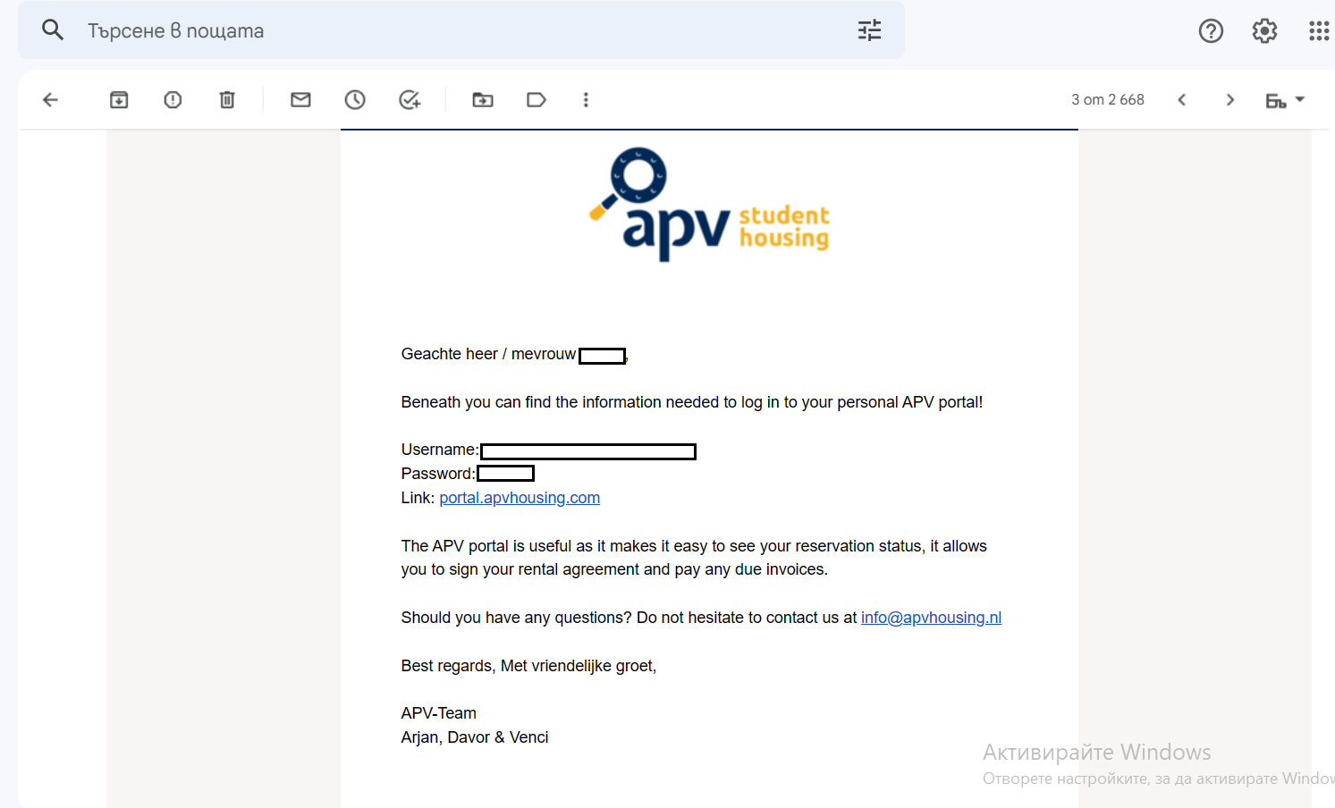
Step1: Receive password (by email)

Slide 7
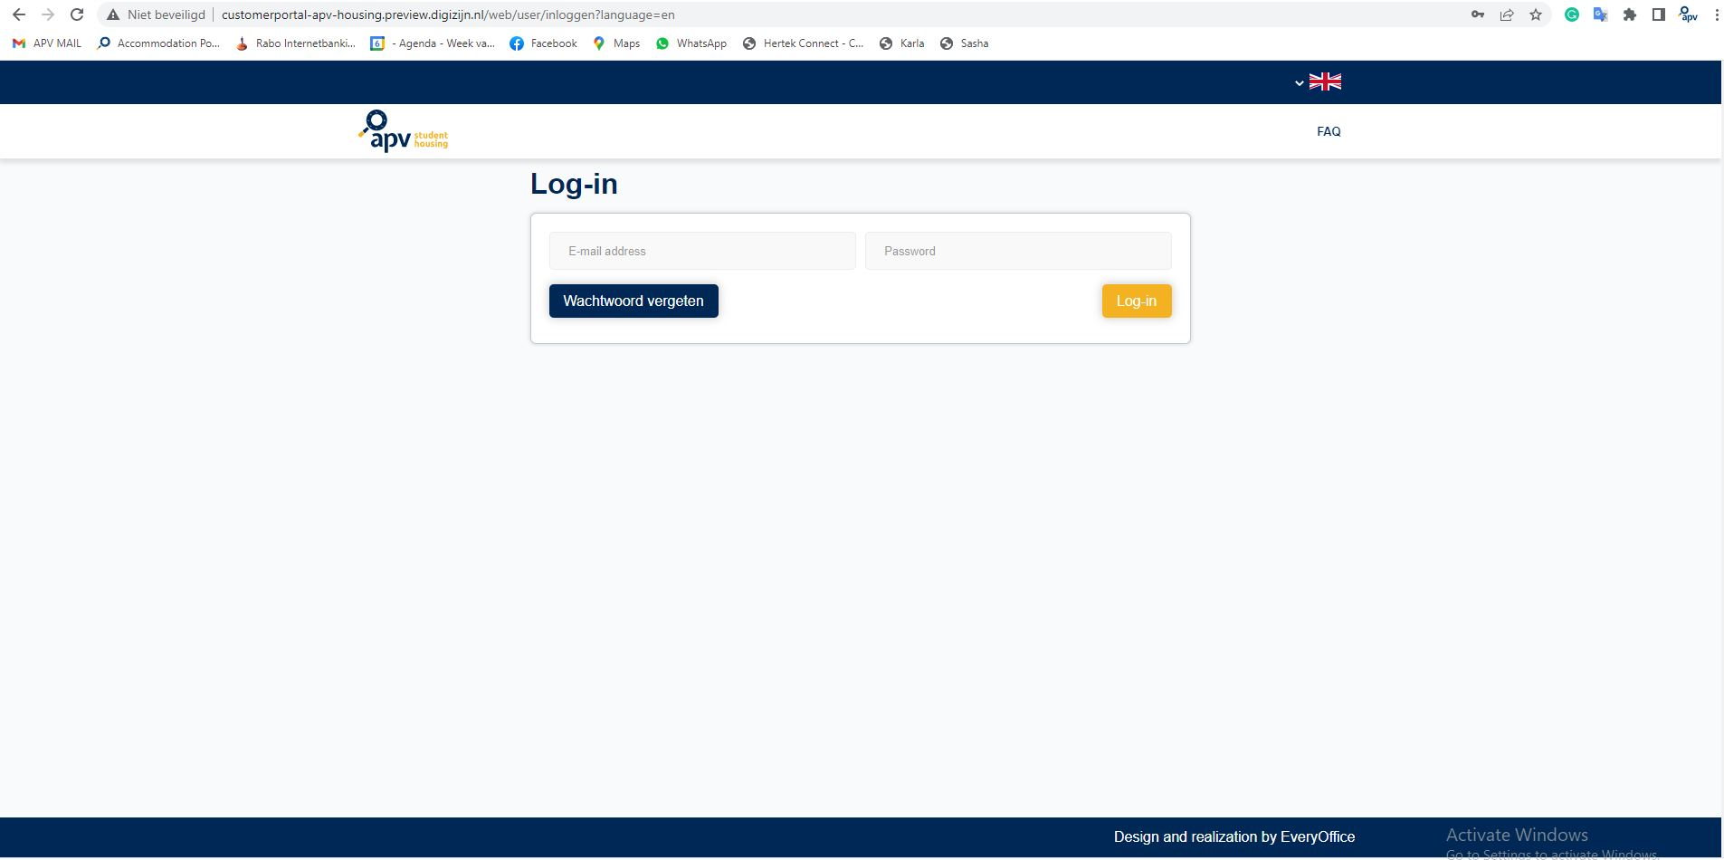
Step 2: Enter APV customer portal
portal.apvhousing.com
In order to log-in to your personal account in APV customer portal you must use your email and the password that was sent to your email!

Slide 8
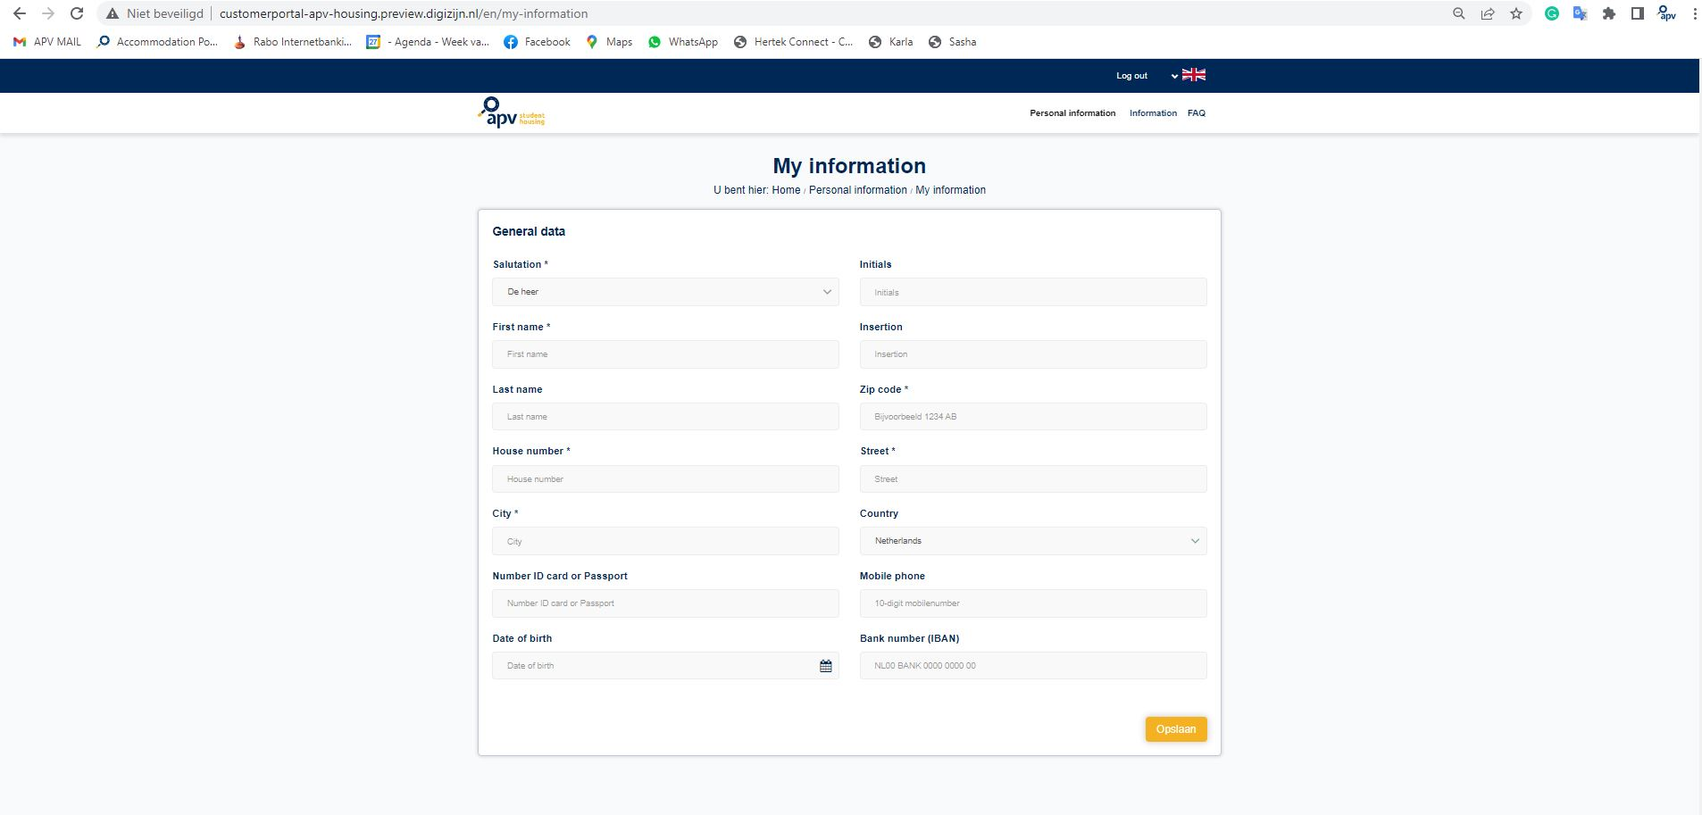
Step 3: Complete your personal information & add bank number (IBAN)
Once you are logged in, click “Personal information” button
Now you MUST provide more information about yourself.
The * symbol marks the required fields.
For your convenience you can add Bank number (IBAN) so you can easily pay your rent through the platform.

Slide 9
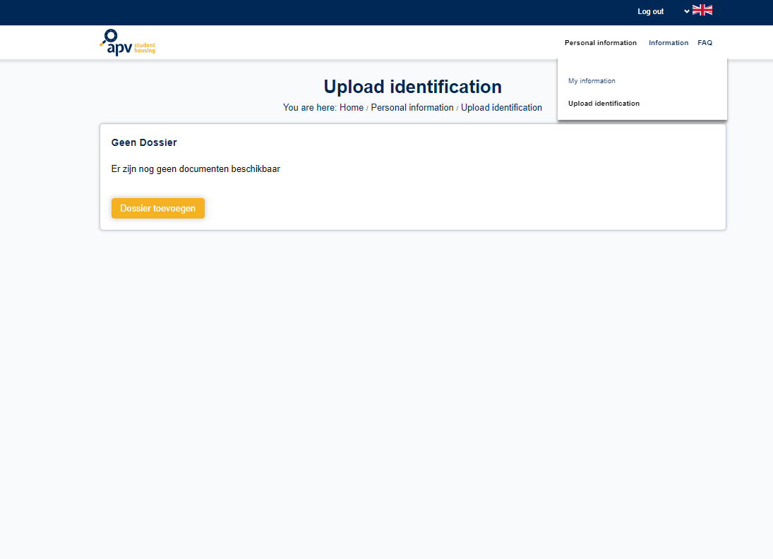
Step 3: Complete your personal information
Upload a scan of your ID or passport
Click here to start

Slide 10
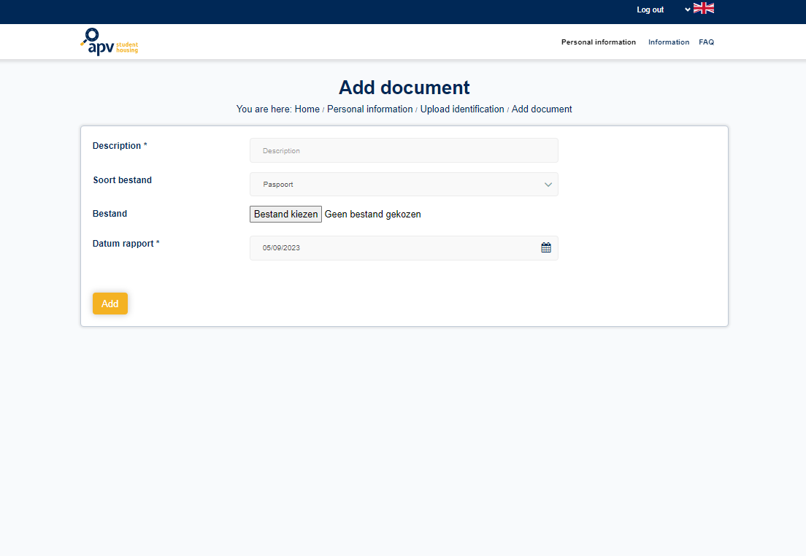
Step 3: Complete your personal information
Add a title to your document upload, example: “ID card Alex”
Click here and select the scan file

Slide 11
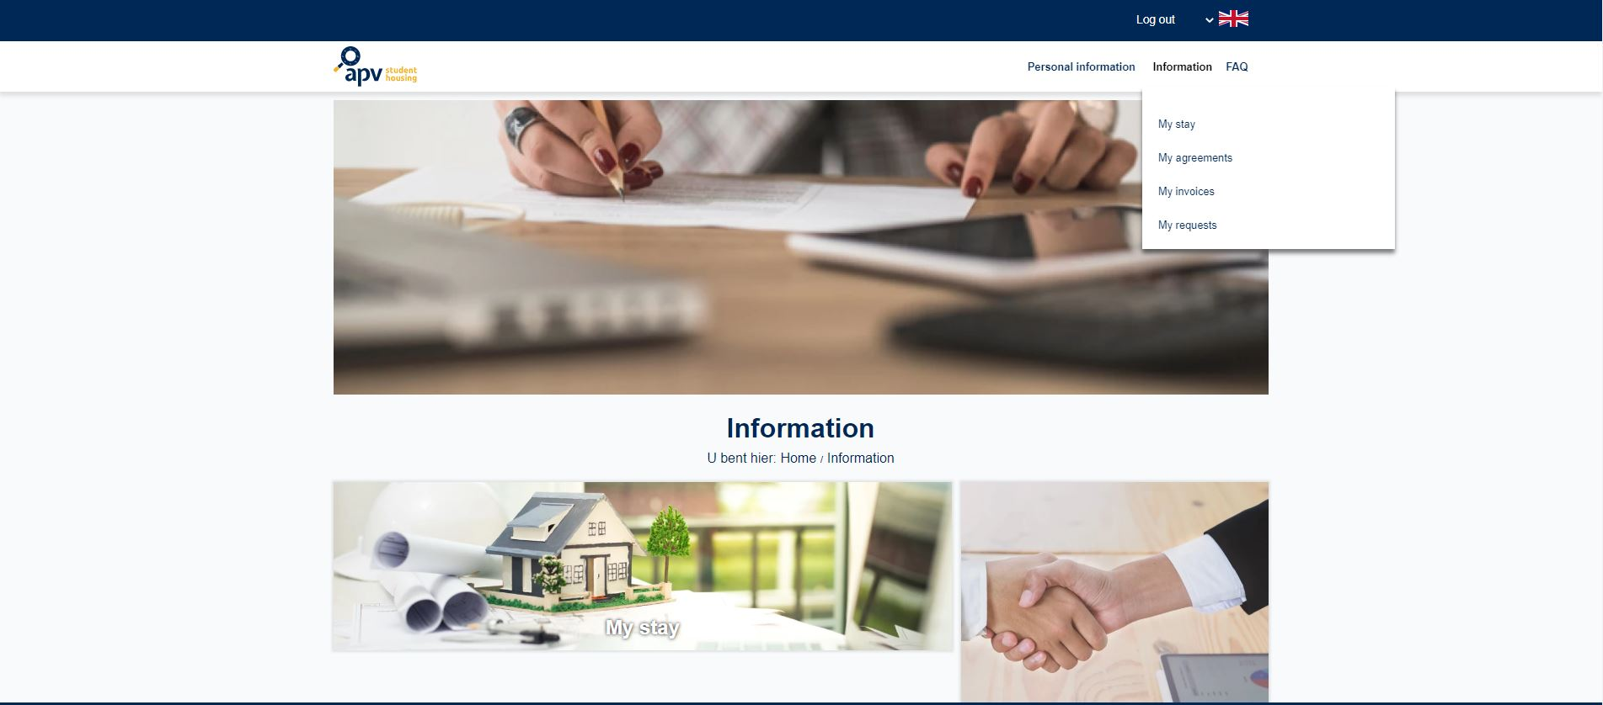
Step 4: Check your stay and overview

Slide 12
Step 4: Check your stay and overview
My stay panel will show you your current reservations with APV Housing and payment info
My invoices this is not a panel that you have to pay attention to. Your payment info is in “My Stay’ tab.
My agreements panel will show you the contracts you need to sign, and the one you have signed already.
My requests panel will allow you to contact us via the platform with your requests

Slide 13
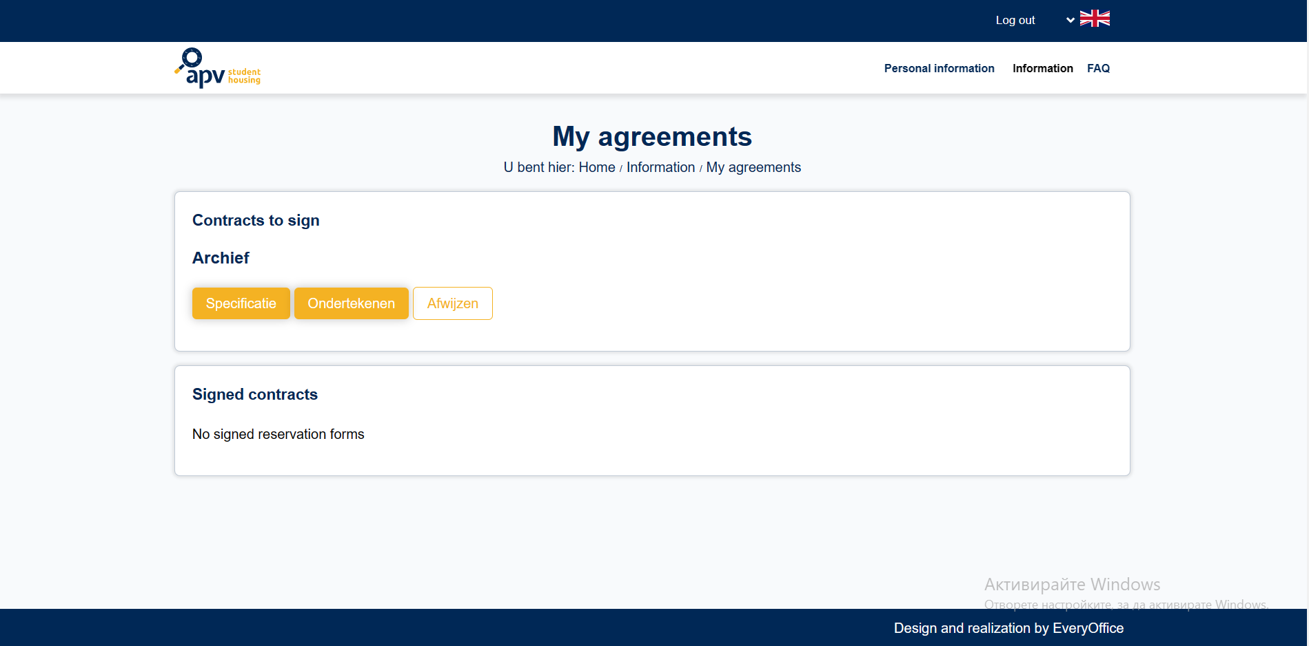
Step 5: Signing your contract
You can check My agreements panel for your contract.
You must press “Ondertekenen” in order to see all the details.

Slide 14
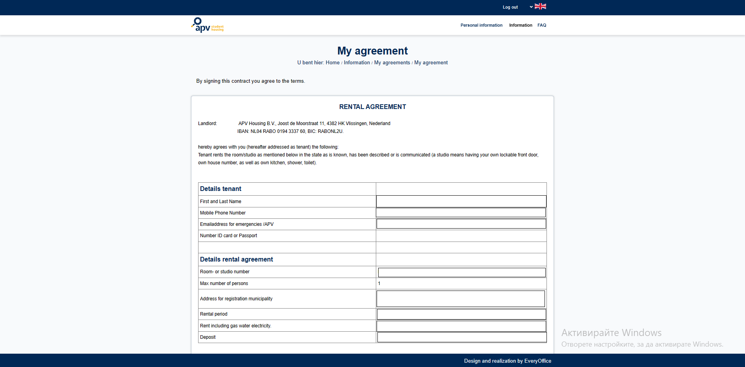
Step 5: Signing your contract
Your personal information and also rental information will be showed here.
Double-check if everything is correct and you can digitally sign your contract!

Slide 15
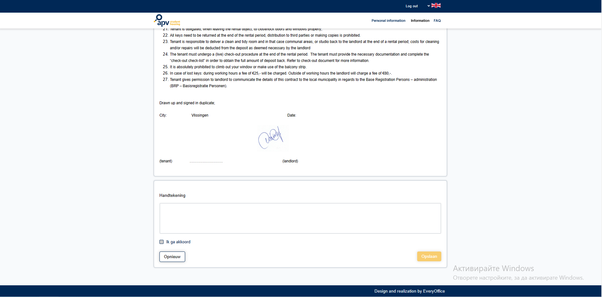
Step 5: Signing your contract
Use your mouse to draw your signature in this field.
After which you must put a check mark to “ik ga akkord”.
Last step is to press Opslaan

Slide 16
Step 5: Signing your contract
That’s it!
You just signed your contract ☺ You can review the signed document at any moment in your portal!

Slide 17
Step 6: Paying deposit and rents
Select “My Stay” to access your payment overview.

Slide 18
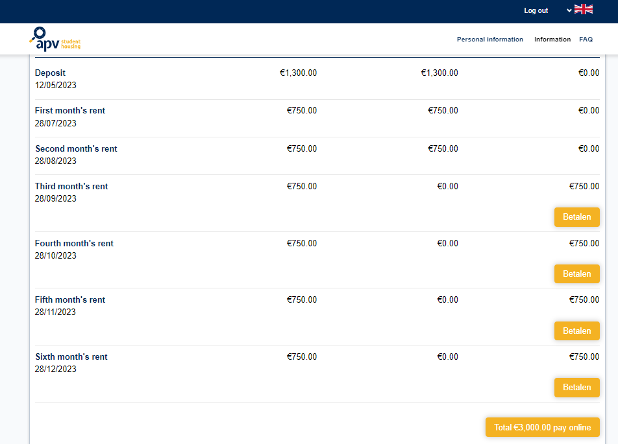
Step 6: Paying deposit and rents
Here you can see the terms (months). You can track what has been paid and what is still due. The deadline of each term is displayed under its name. In order to pay a term, click on the orange button on that row.

Slide 19
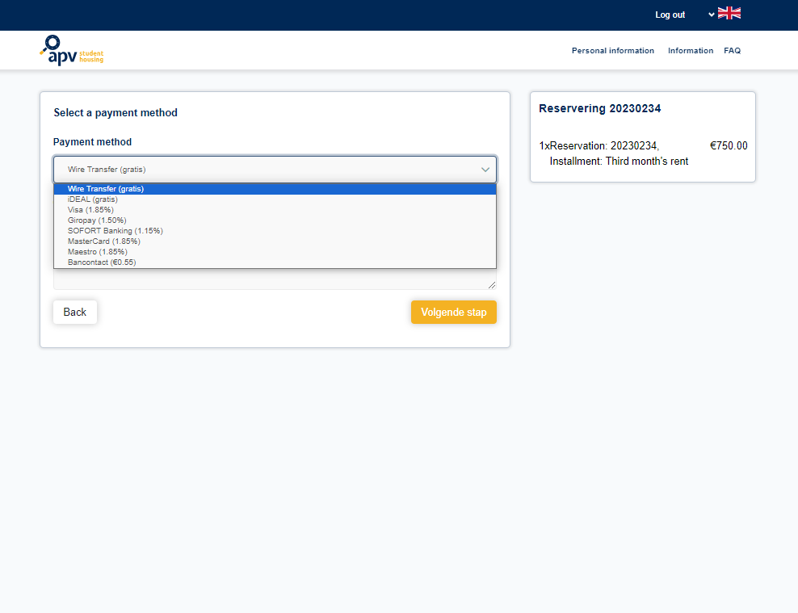
Step 6: Paying deposit and rents
You can choose between multiple payment options in order to transfer the rent/deposit. Refer to the FAQ section in your portal to find a detailed explanation about each option.

Slide 20
Deposit – beware the deadline!
Are you a new customer trying to finalize your reservation? Then we have asked you to pay your deposit.
Please make sure to process the payment before the deadline indicated on your portal.
Keep in mind that paying with the option “Wire Transfer” has a technical processing time of 3-4 days. Take this period into account when aligning your schedule with the deadline.

Slide 21
THANKS!
Any questions?
You can find us at:
info@apvhousing.nl

