Slide 1
APV Accommodation and more!
City Taxes Exemption

Slide 2
Index
What are city taxes? Does everybody receive them?
Prerequisites for application
Necessary documents for tax exemption
Procedure with screenshots.

Slide 3
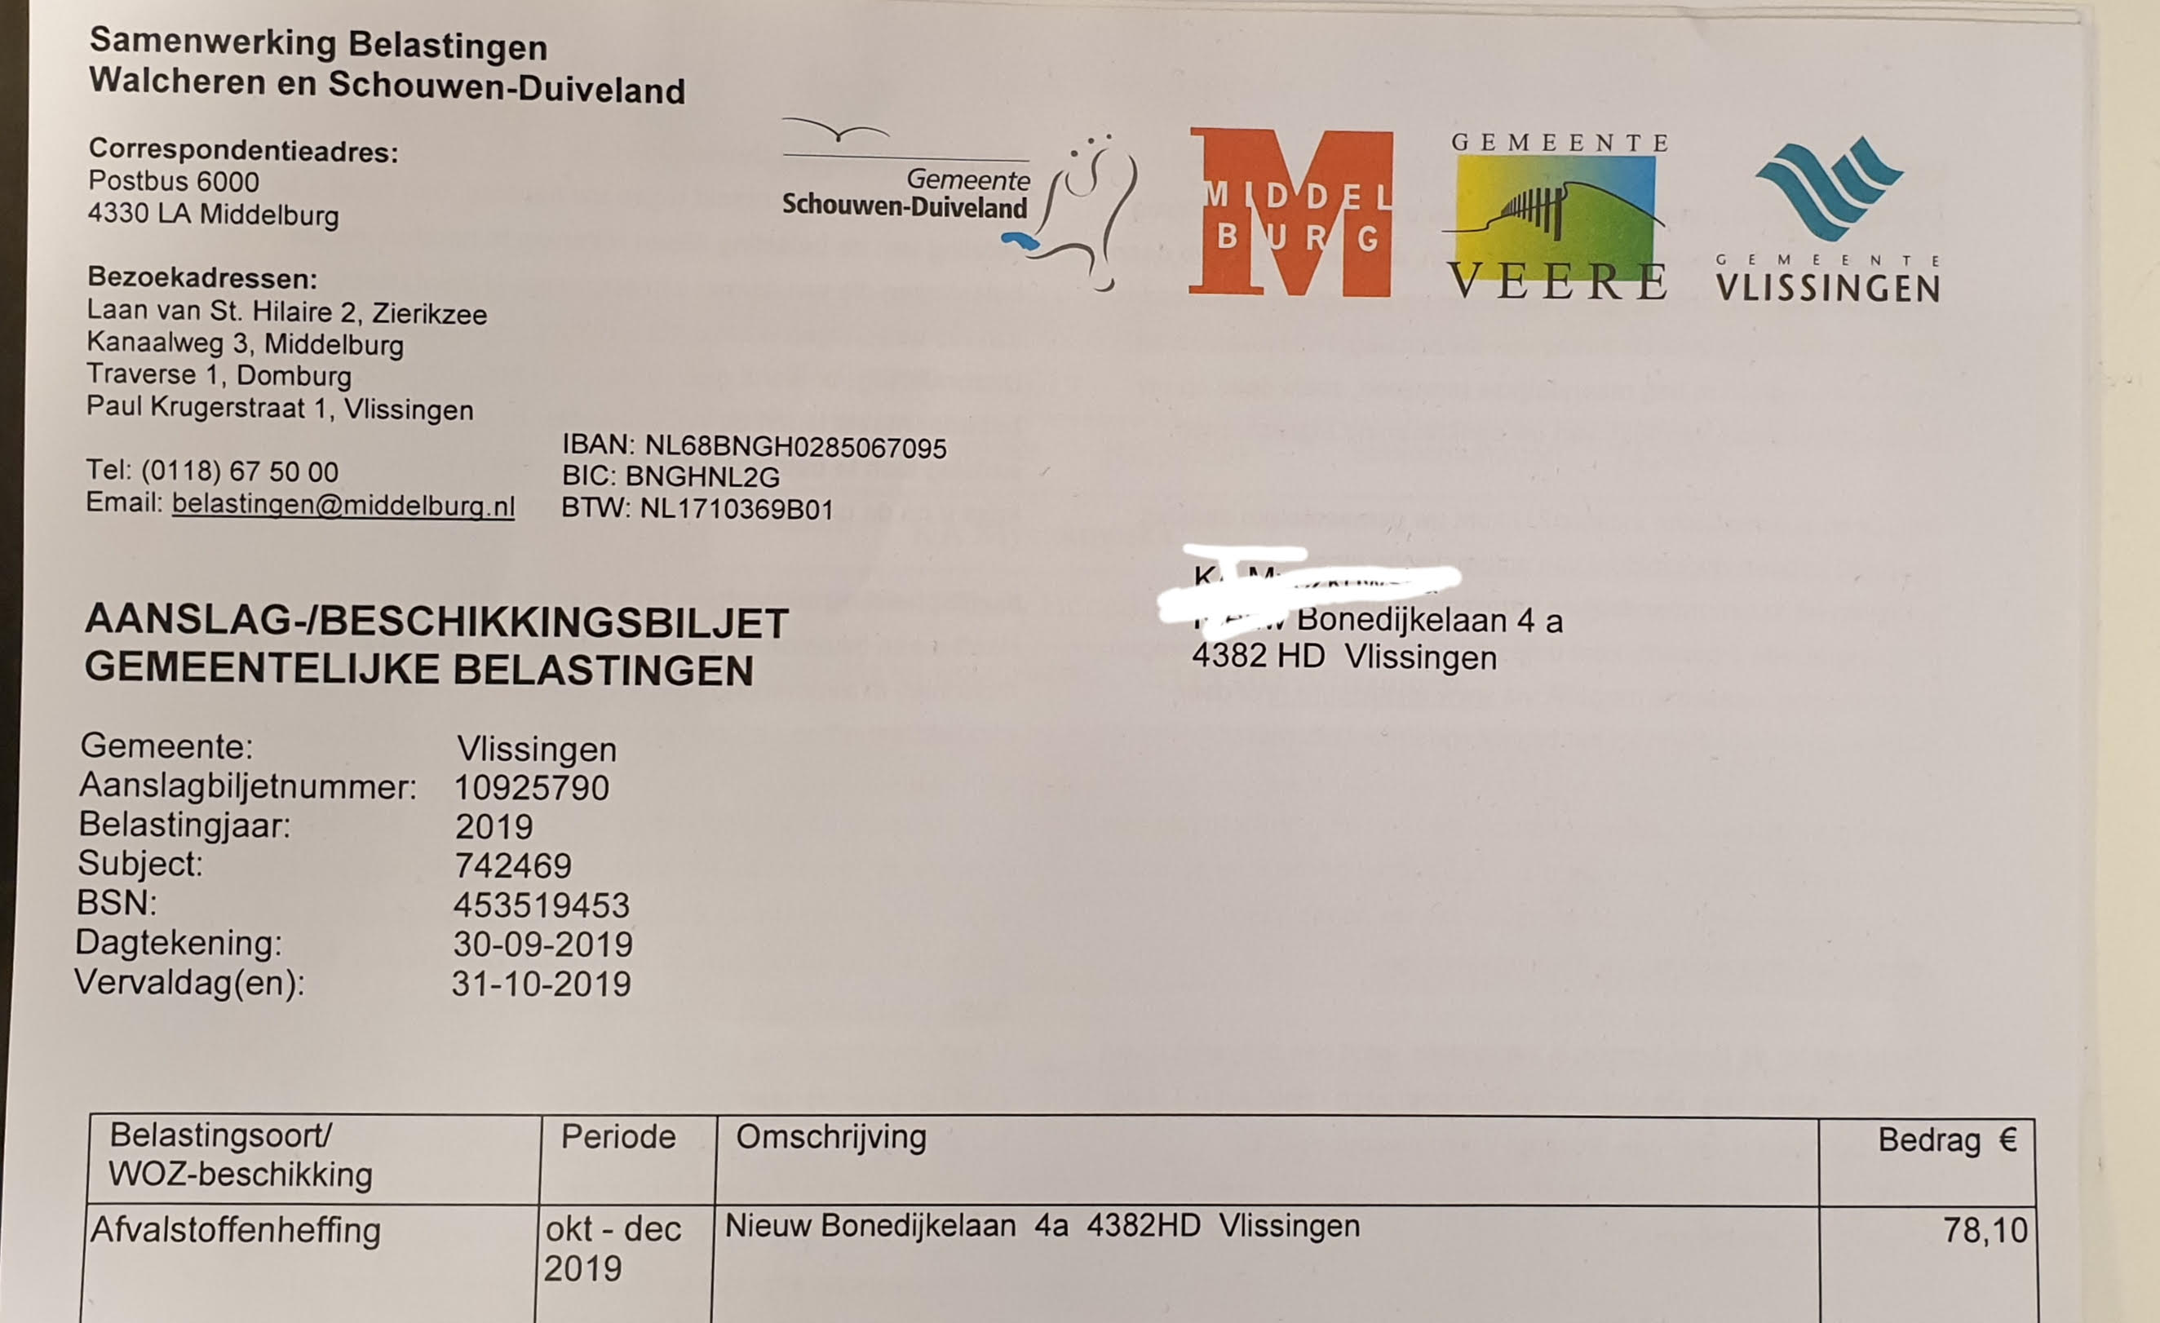

Slide 4
What are city taxes? Does everybody receive them?
City taxes are a contribution towards your municipality. Such contributions involve, for example, the waste disposal & recycling taxes.
Every household in Holland is asked to pay those taxes.
If you live in an apartment or a studio with your own address and facilities, then you are to be considered a household and thus
Students with low or no income can be exempted from such taxes.

Slide 5
Prerequisites for requesting the tex exemption
You must have an active DigID account. If you need help with the application for your DigID follow our guide!
You must make sure that your bank balance in the current account is not higher than €1000,-

Slide 6
Necessary documents for tax exemption
Income statement (salary slips) of the two most recent months. In case you do not have an income you can just create a Word file with the following sentence: Mijn naam is "fill in your name" en ik woon op het adres; "fill in your address" Ik ben student aan de HZ University of Applied Sciences en ik heb momenteel geen inkomen uit werk.Sign it and make sure your bsn number is on it plus the number that is on the invoice called "Aanslagbiljetnummer“
Bank transcripts of the two most recent months. (Saldo no bigger than €1000!)
Your insurance policy. In case you do not have this document, you will atleast need your European insurance card.
Your rental agreement with us.
Additonal documents may be needed in case you are receiving any sort of subsidies (insurance or housing), study grants and if you have a registered vehicle in The Netherlands.

Slide 7
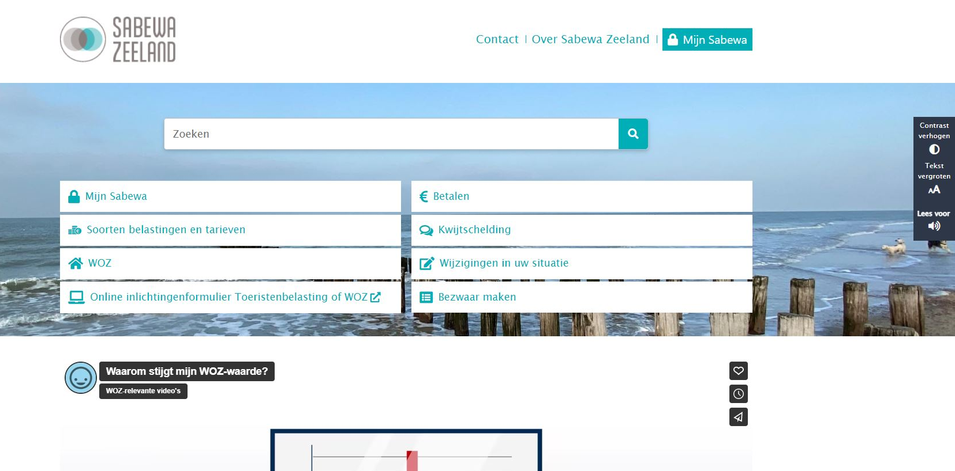
Step 1: Log in
https://www.sabewazeeland.nl/

Slide 8
Step 1: Log In

Slide 9
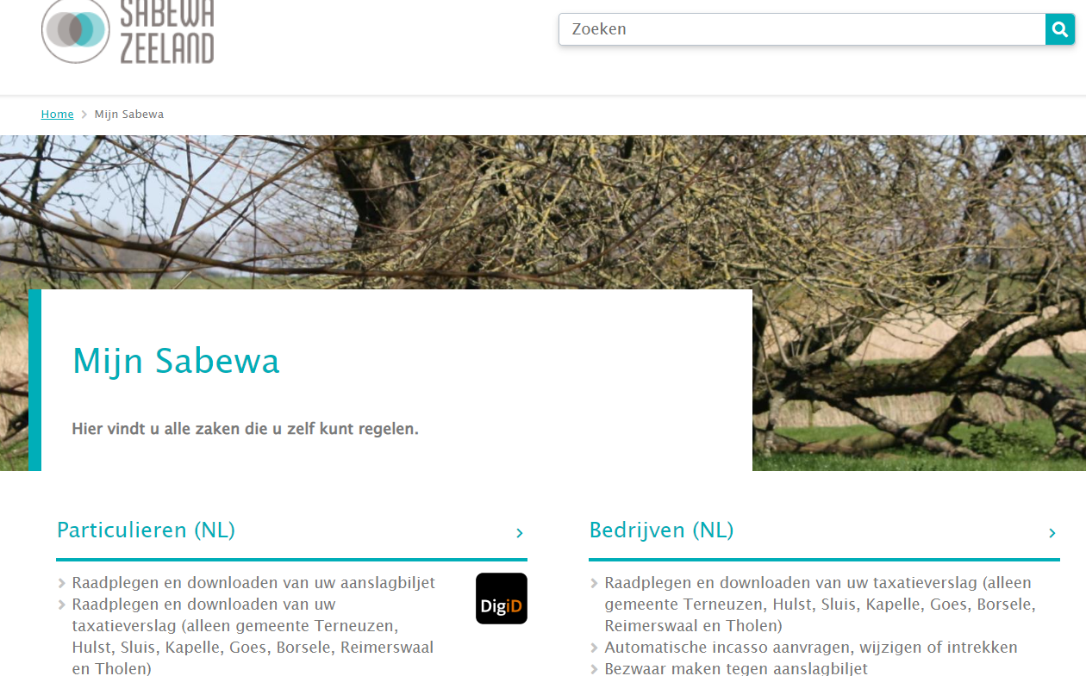
Step 1: Log In

Slide 10
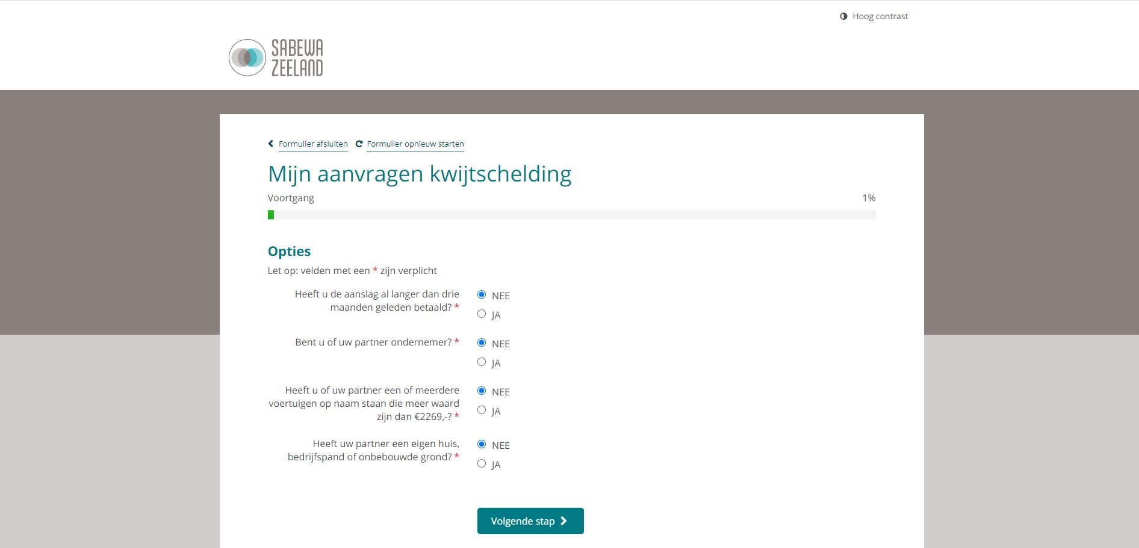
Step 2: Agree to pre-conditions

Slide 11
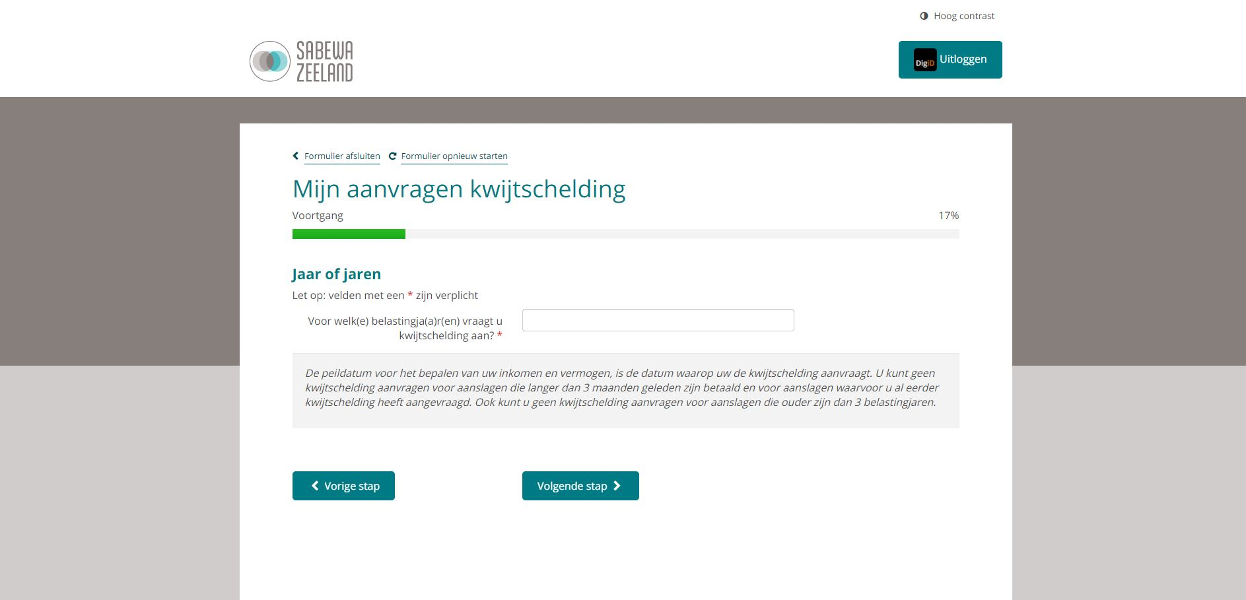
Step 3: Indicate the year
You can see the year on the letter that you received. See an example here.

Slide 12
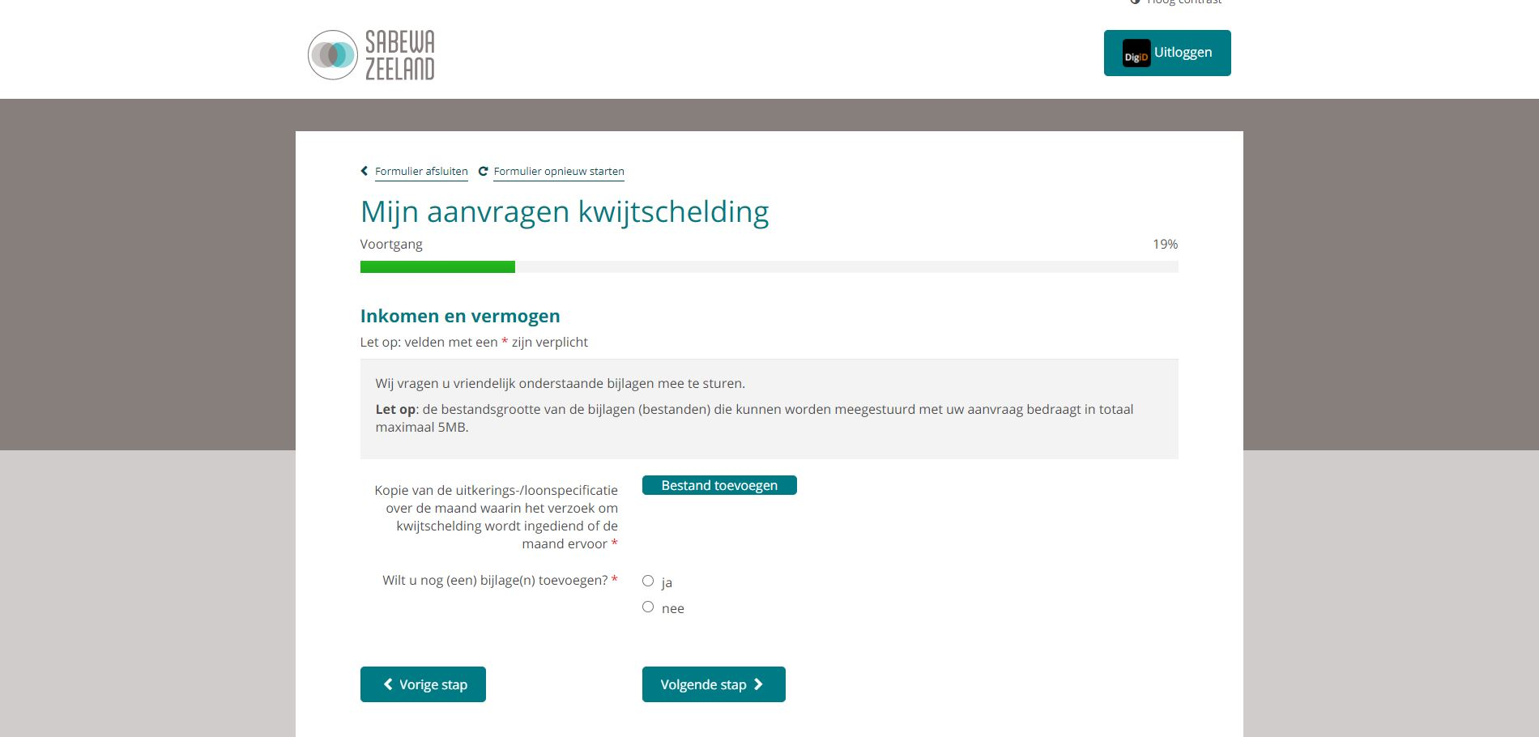
Step 4: Upload pay slips or income statement
In case you have a job, upload your payslipls from the last two months here! If you do not have a work related income, create a word document with the following text: Mijn naam is "fill in your name" en ik woon op het adres; "fill in your address" Ik ben student aan de HZ University of Applied Sciences en ik heb momenteel geen inkomen uit werk.Sign it and make sure your bsn number is on it plus the number that is on the invoice called "Aanslagbiljetnummer“
Ja in case you have more than one file to attach. Nee in case you only needed to attach one file.

Slide 13
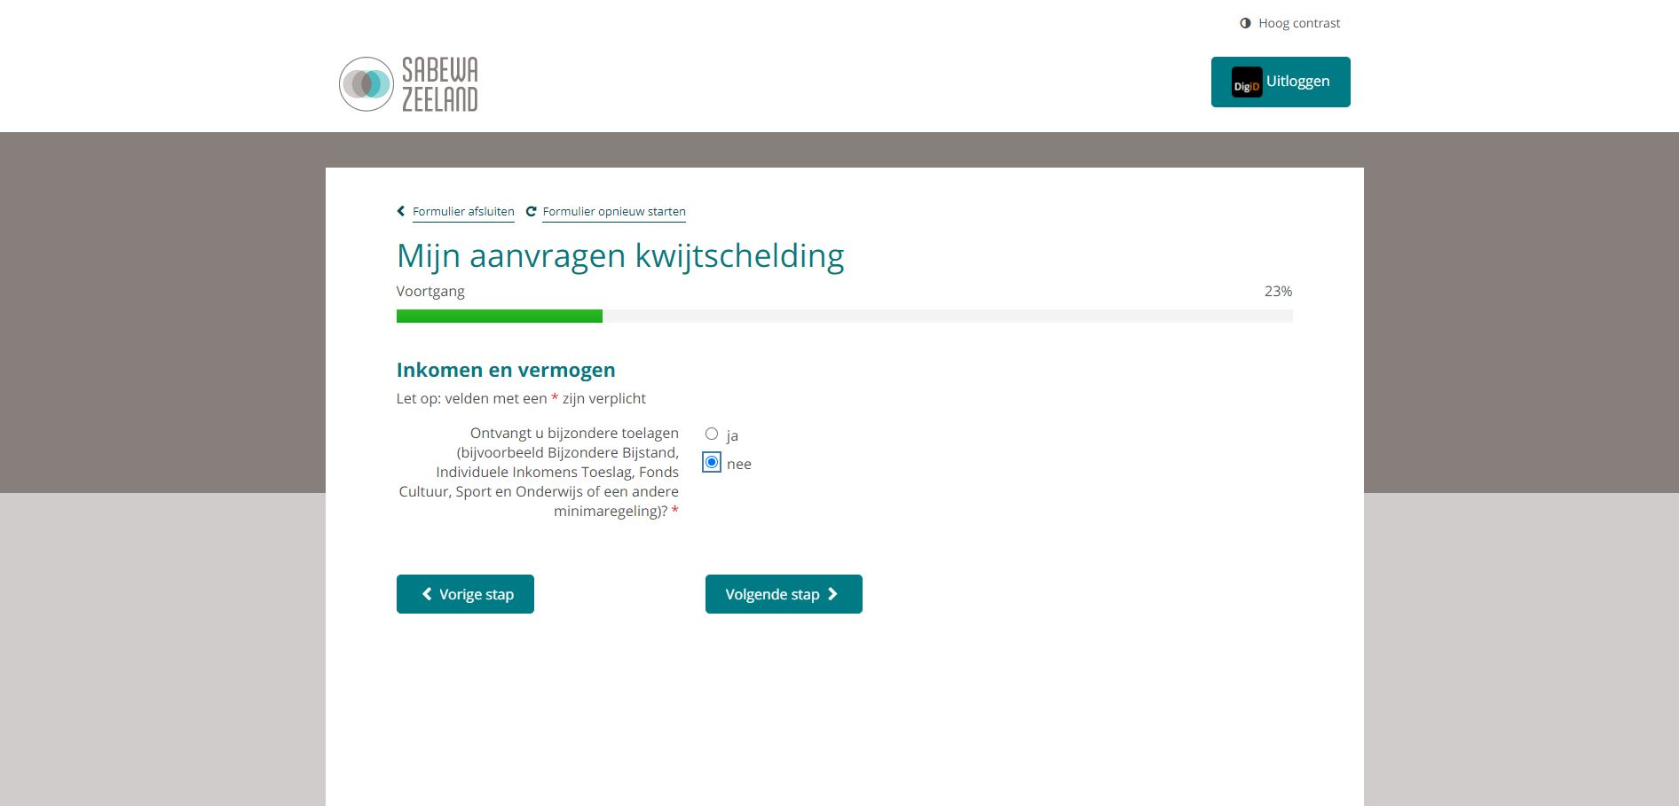
Step 5: Special subsidies
Select nee here

Slide 14
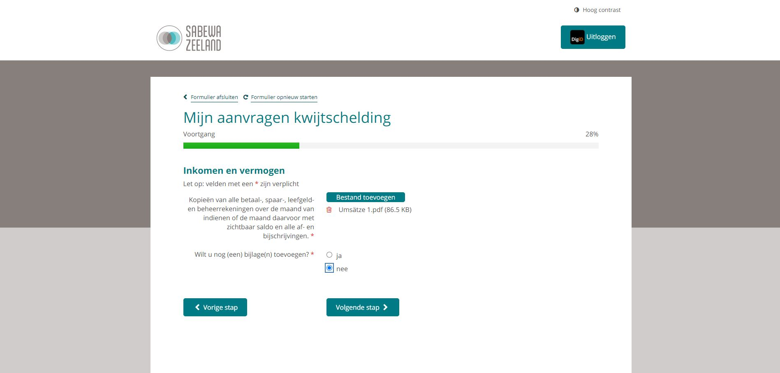
Step 6: Upload 2 months of bank transcripts
Upload bank transcripts for the 2 most recent months. You saldo should not go beyond €1000,- at any point of time in the two months that you are uploading
Ja in case you have more than one file to attach. Nee in case you only needed to attach one file.

Slide 15
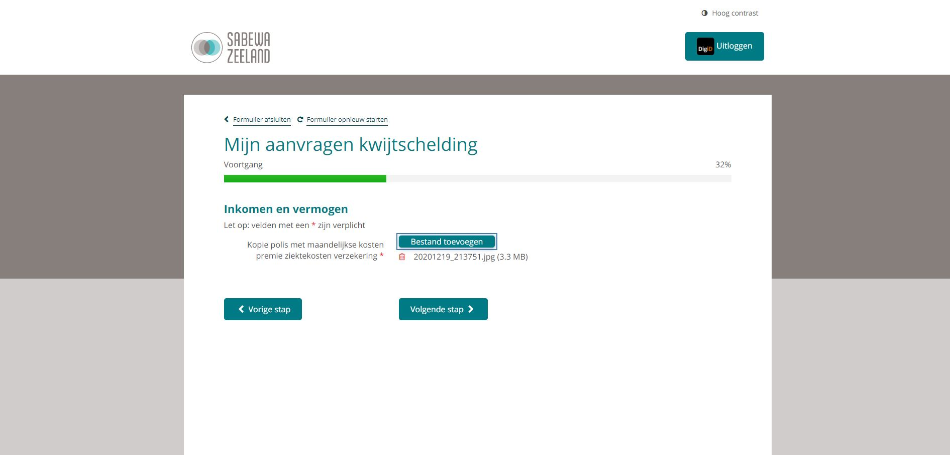
Step 7: Upload your health insurance policy
Upload your most recent insurance policy. If you do not have one, upload an European health card.

Slide 16
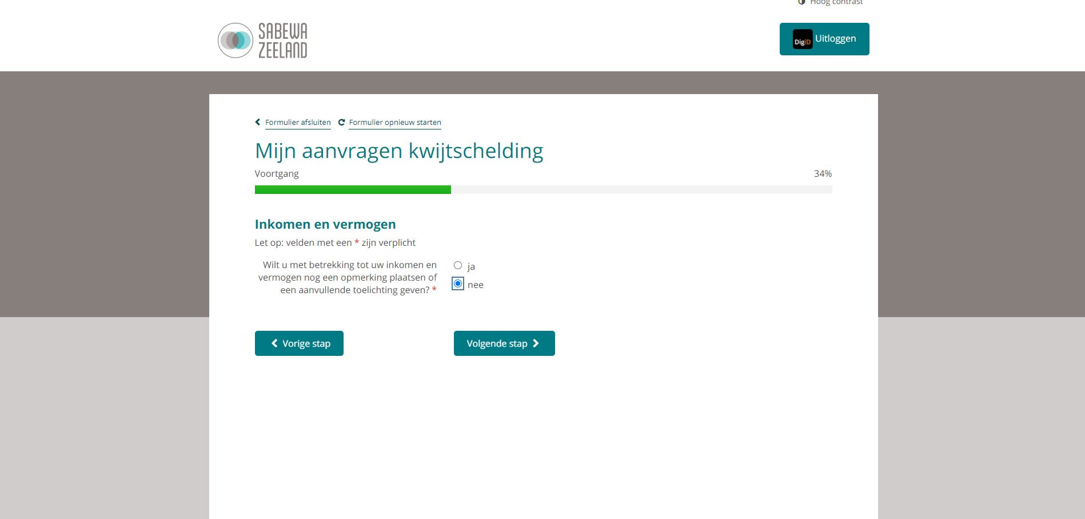
Step 8: Additional explanation

Slide 17
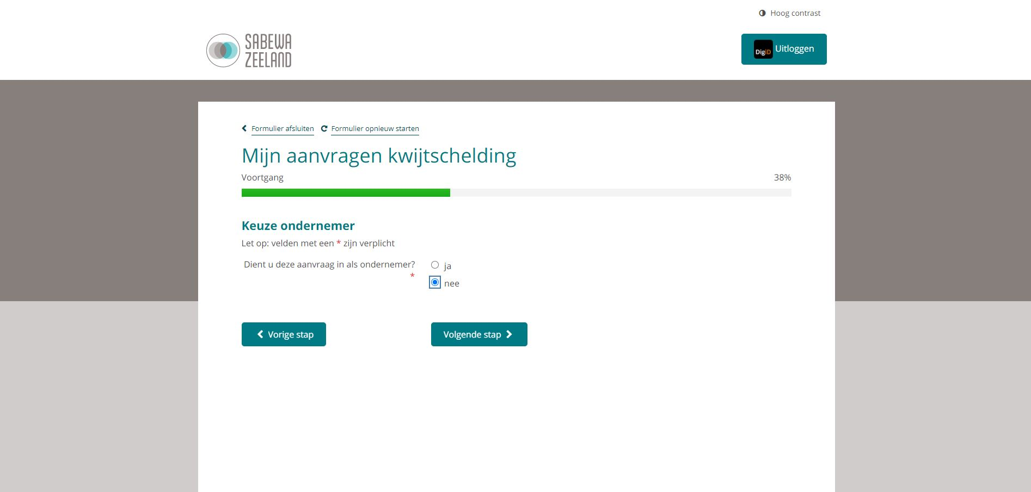
Step 9

Slide 18
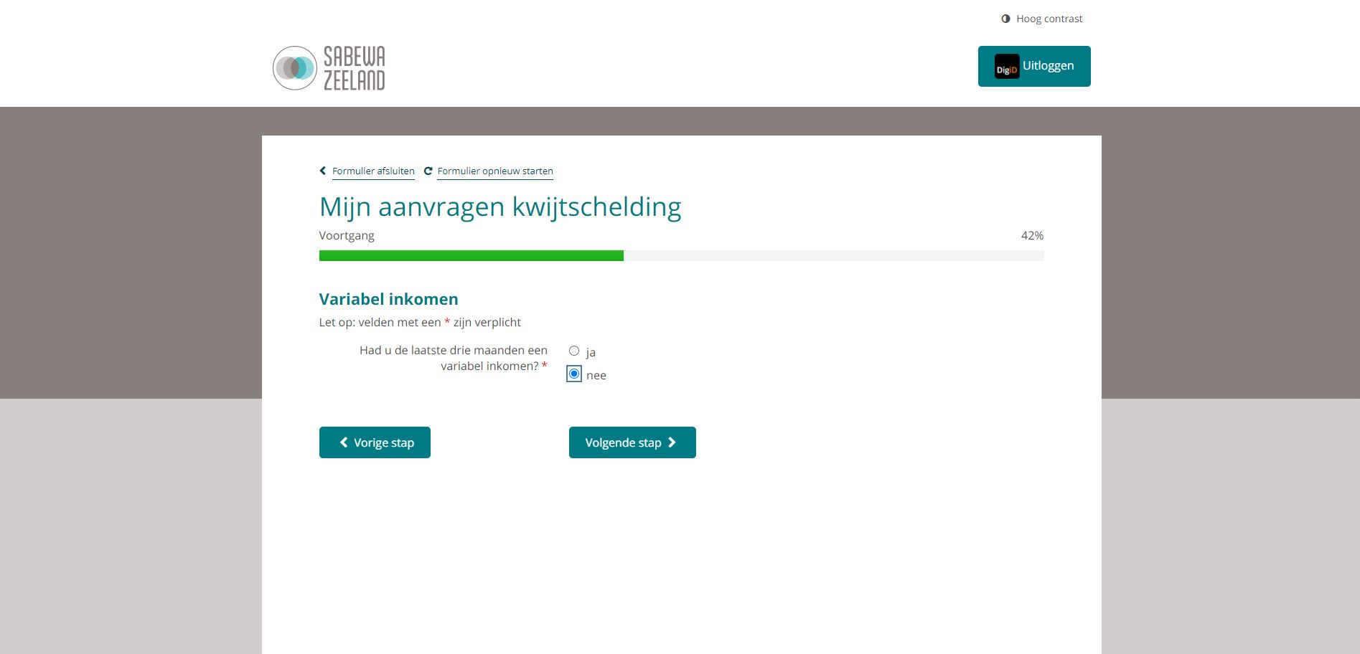
Step 10: Variable income

Slide 19
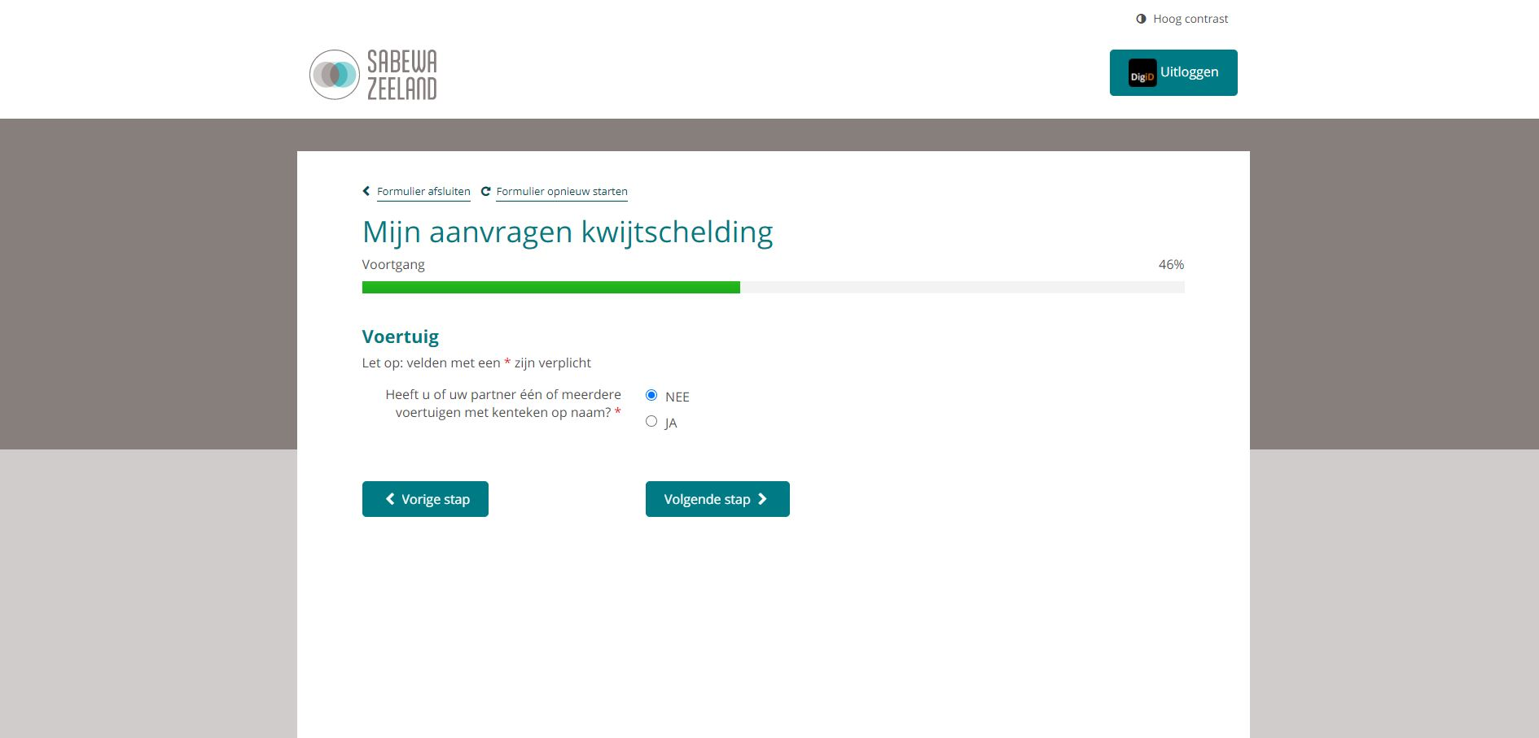
Step 11: Registered vehicle
Select Nee in case you do not own a registered vehicle in the Netherlands. Select Ja otherwise.
Proceed with thus guide HERE if you do not own a vehicle. Otherwise just go to next slide.

Slide 20
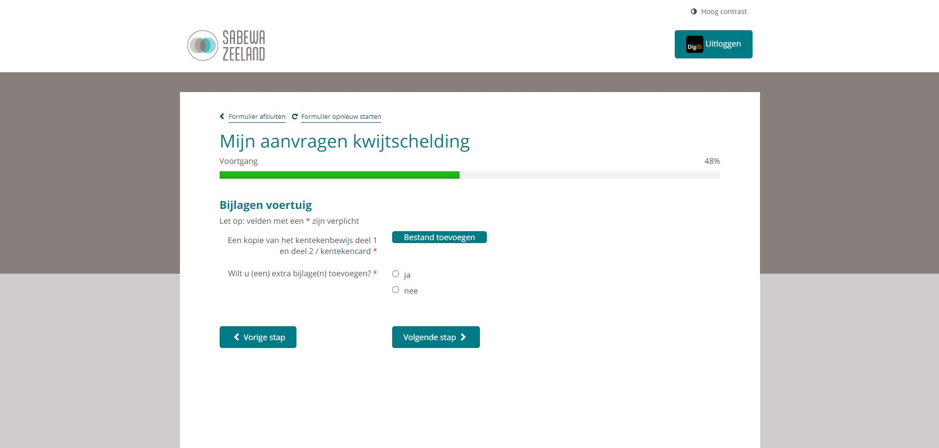
Step 11 (plus):
Upload license plate and card of the vehicle

Slide 21
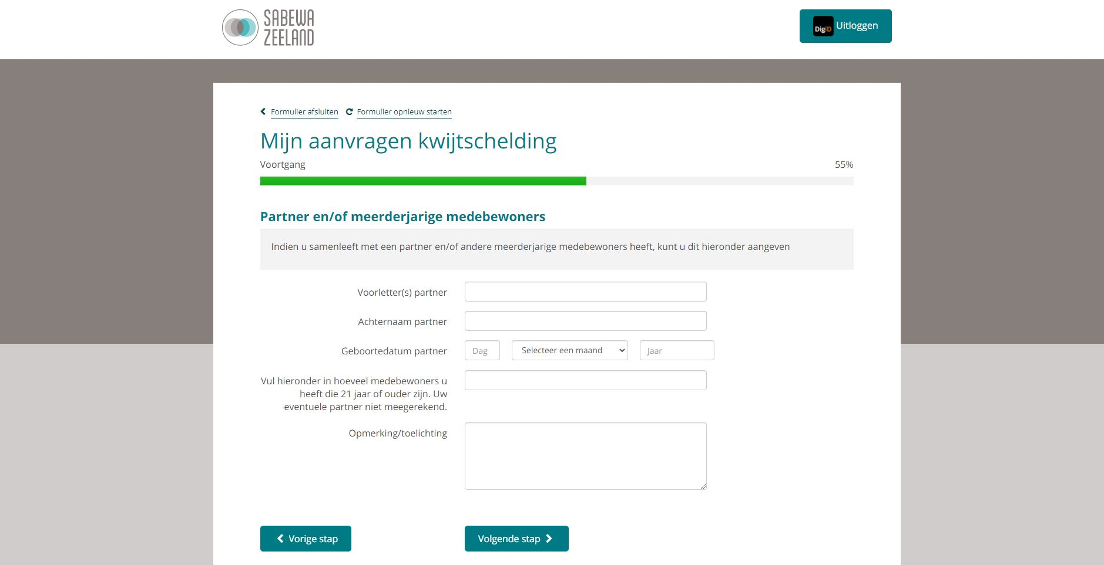
Step 12: Roommate
Fill this in case you have a registered roommate, otherwise leave blank and proceed to next step.

Slide 22
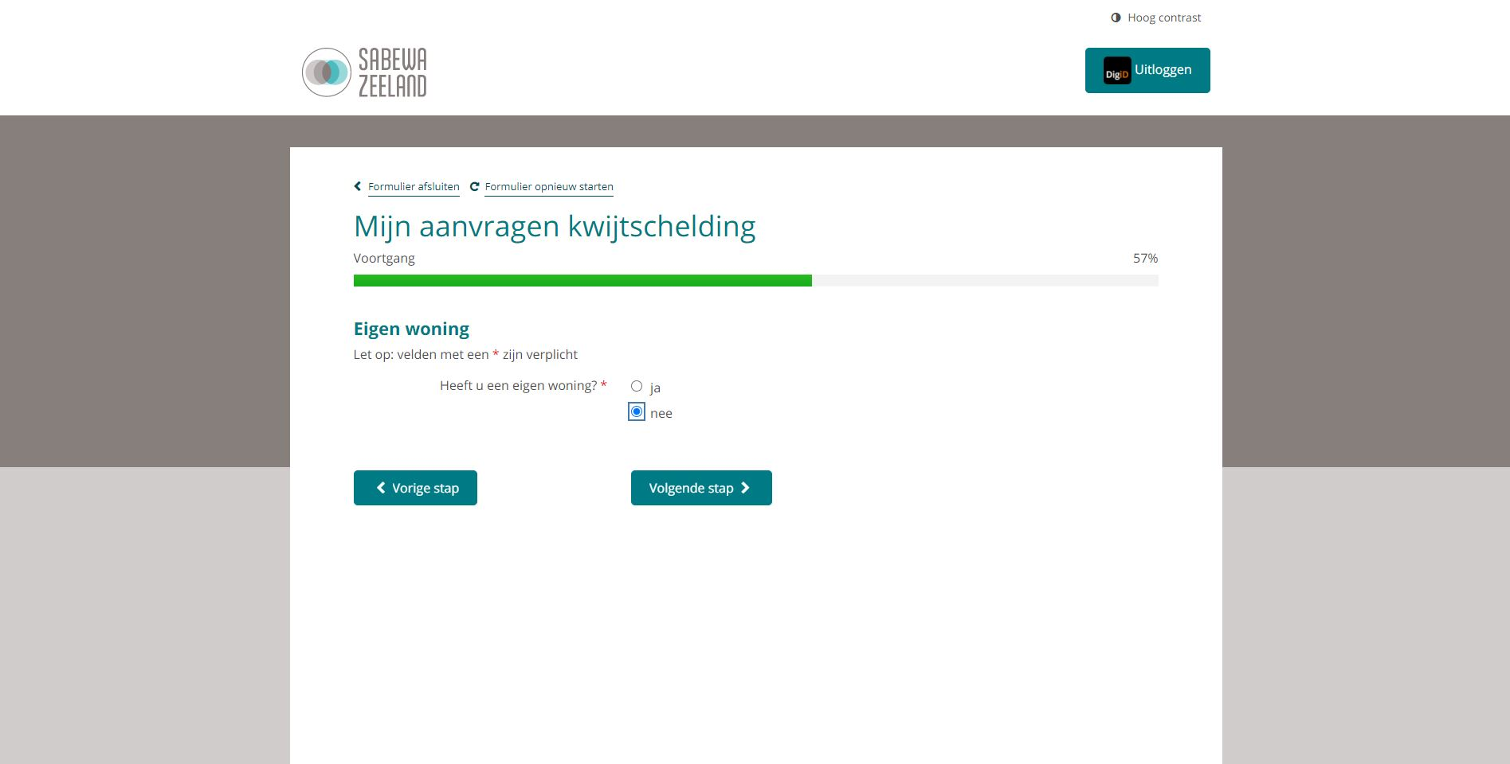
Step 13:

Slide 23
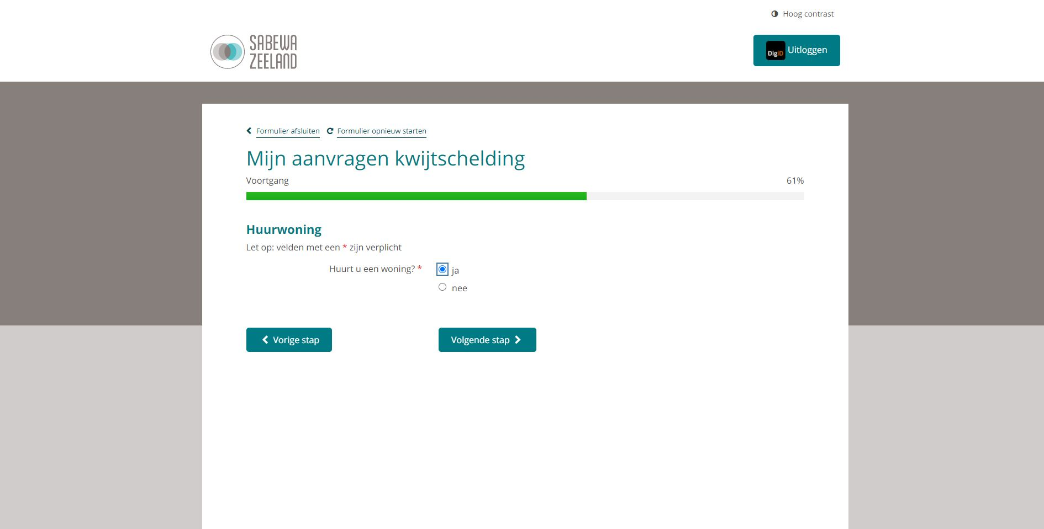
Step 14

Slide 24
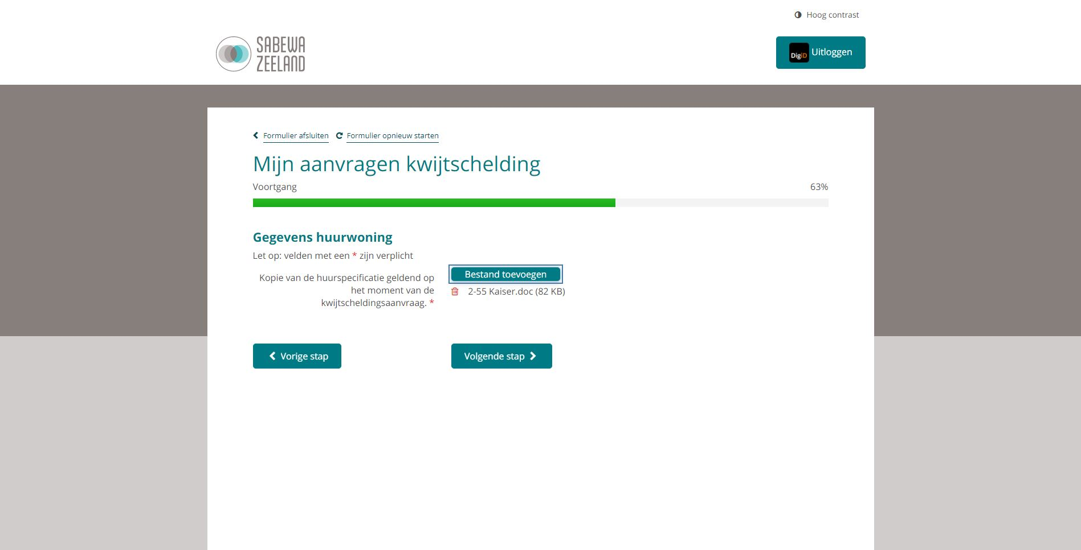
Step 15: Upload rental agreement for your accommodation
Upload your APV contract here.

Slide 25
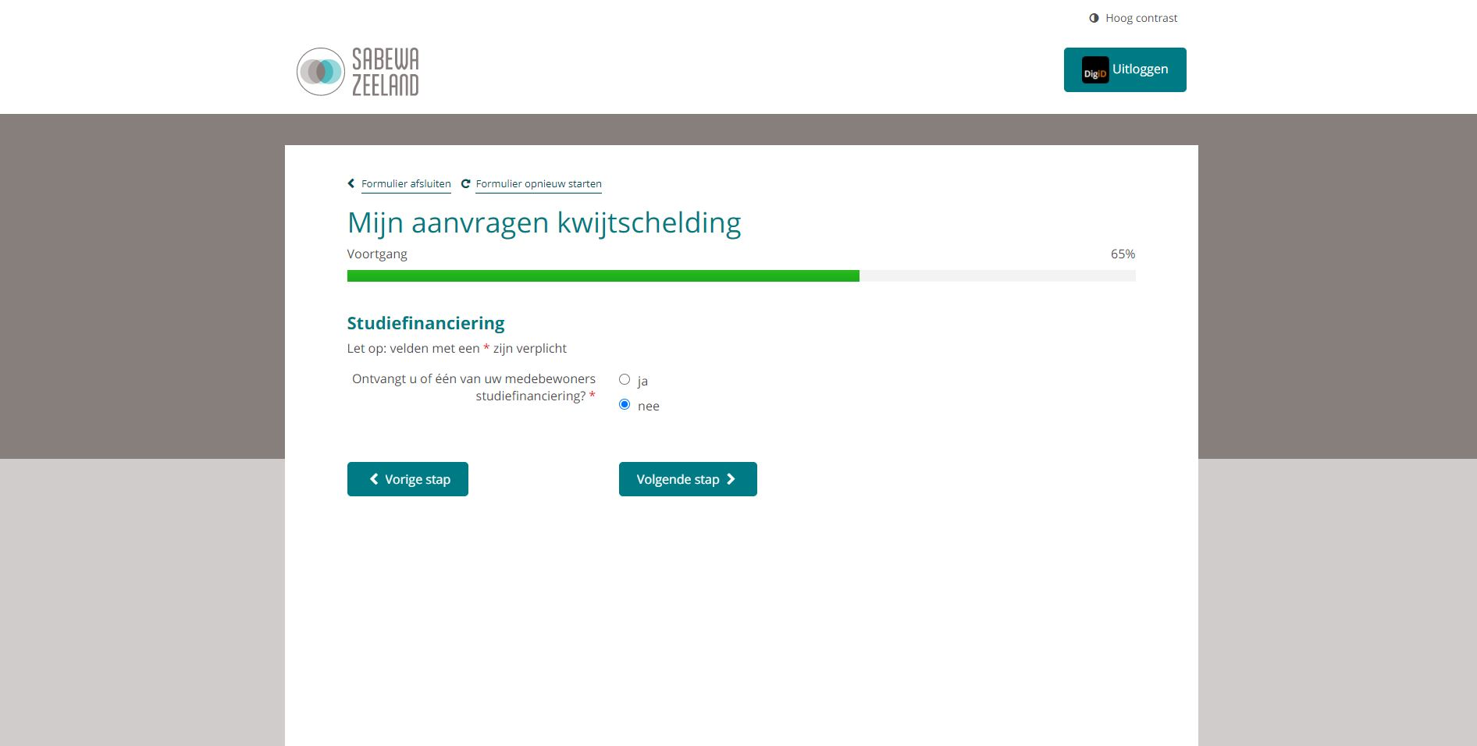
Step 16: Do you receive student grants? (DUO)
Select Nee in case you do not receive student grants. Select Ja otherwise.
Proceed with this guide HERE if you do not receive student grants. Otherwise just go to next slide.

Slide 26
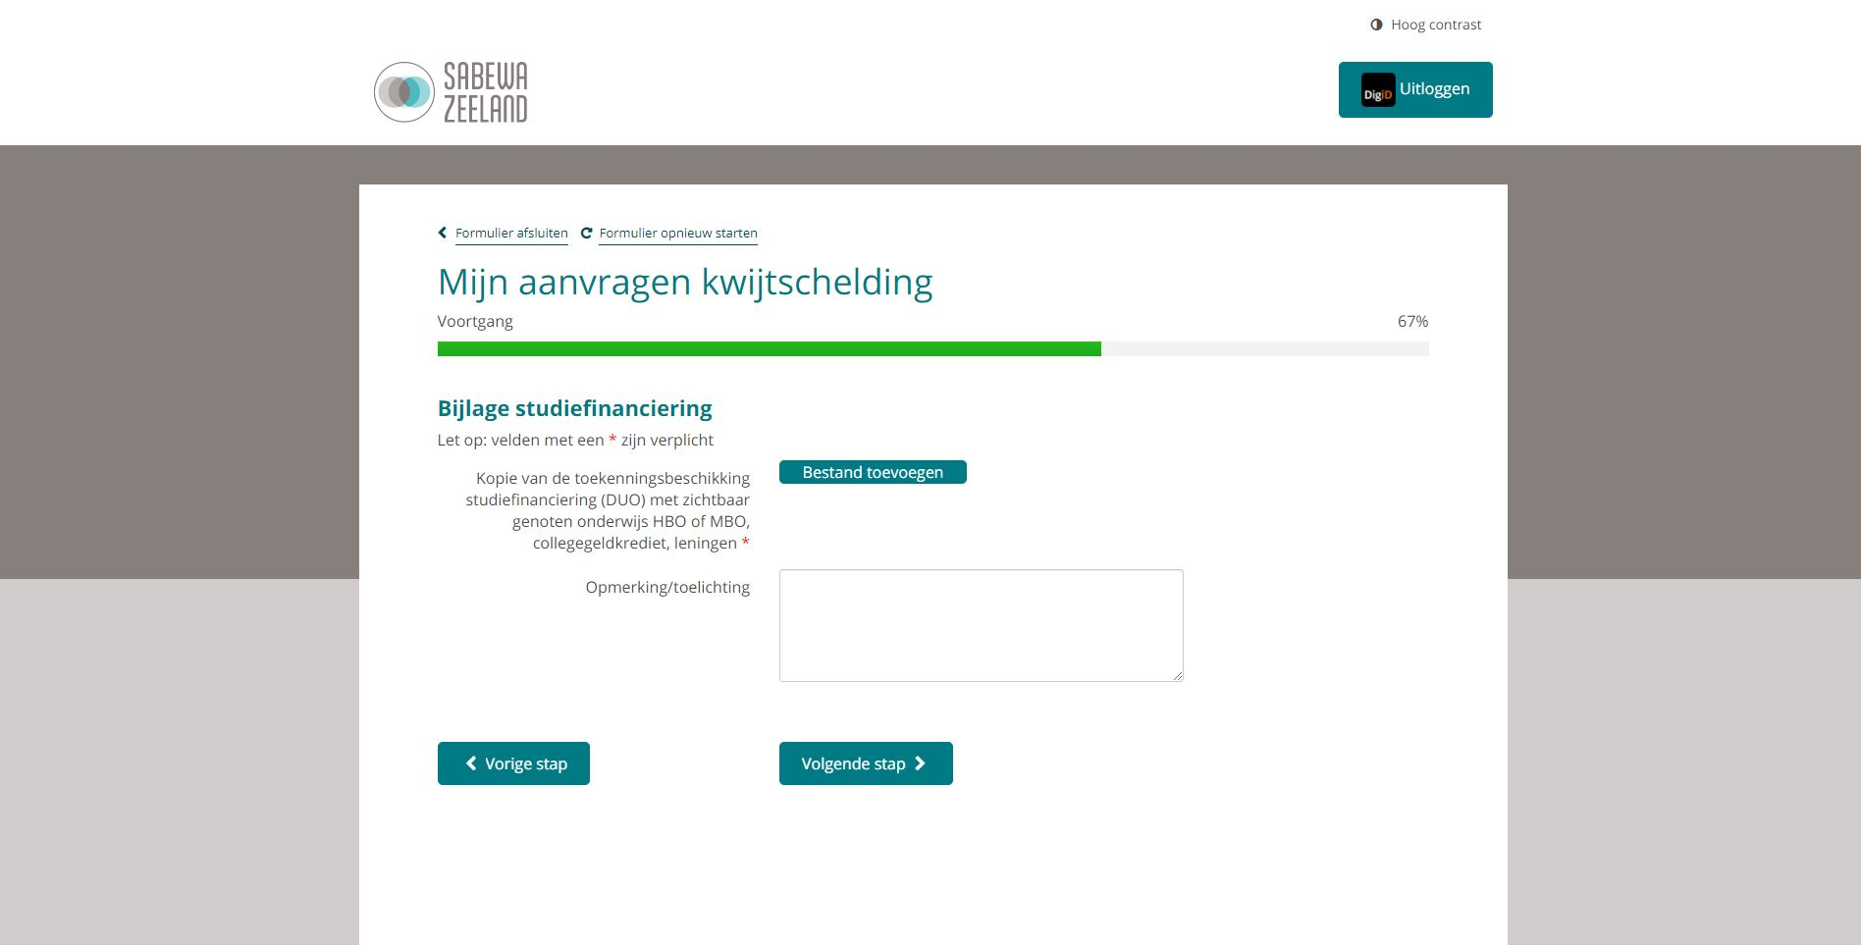
Step 16 (Plus): Upload DUO screenshot
Upload a screenshot which summarizes the student grants and financing that you are receiving. If it is issued by the Netherlands, you can find this info on DUO.nl

Slide 27
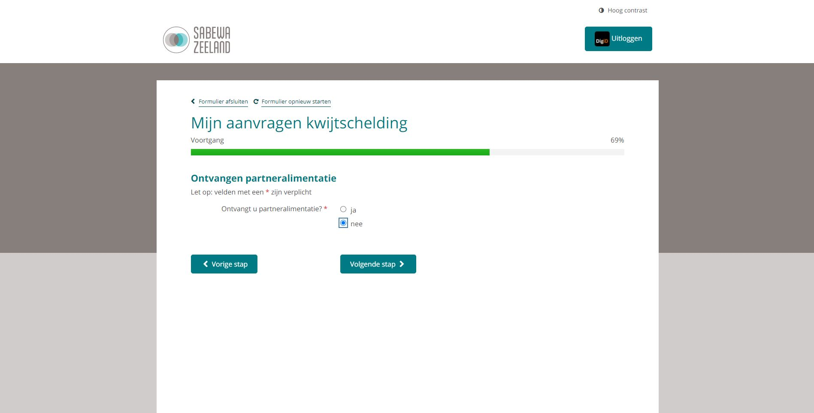
Step 17

Slide 28
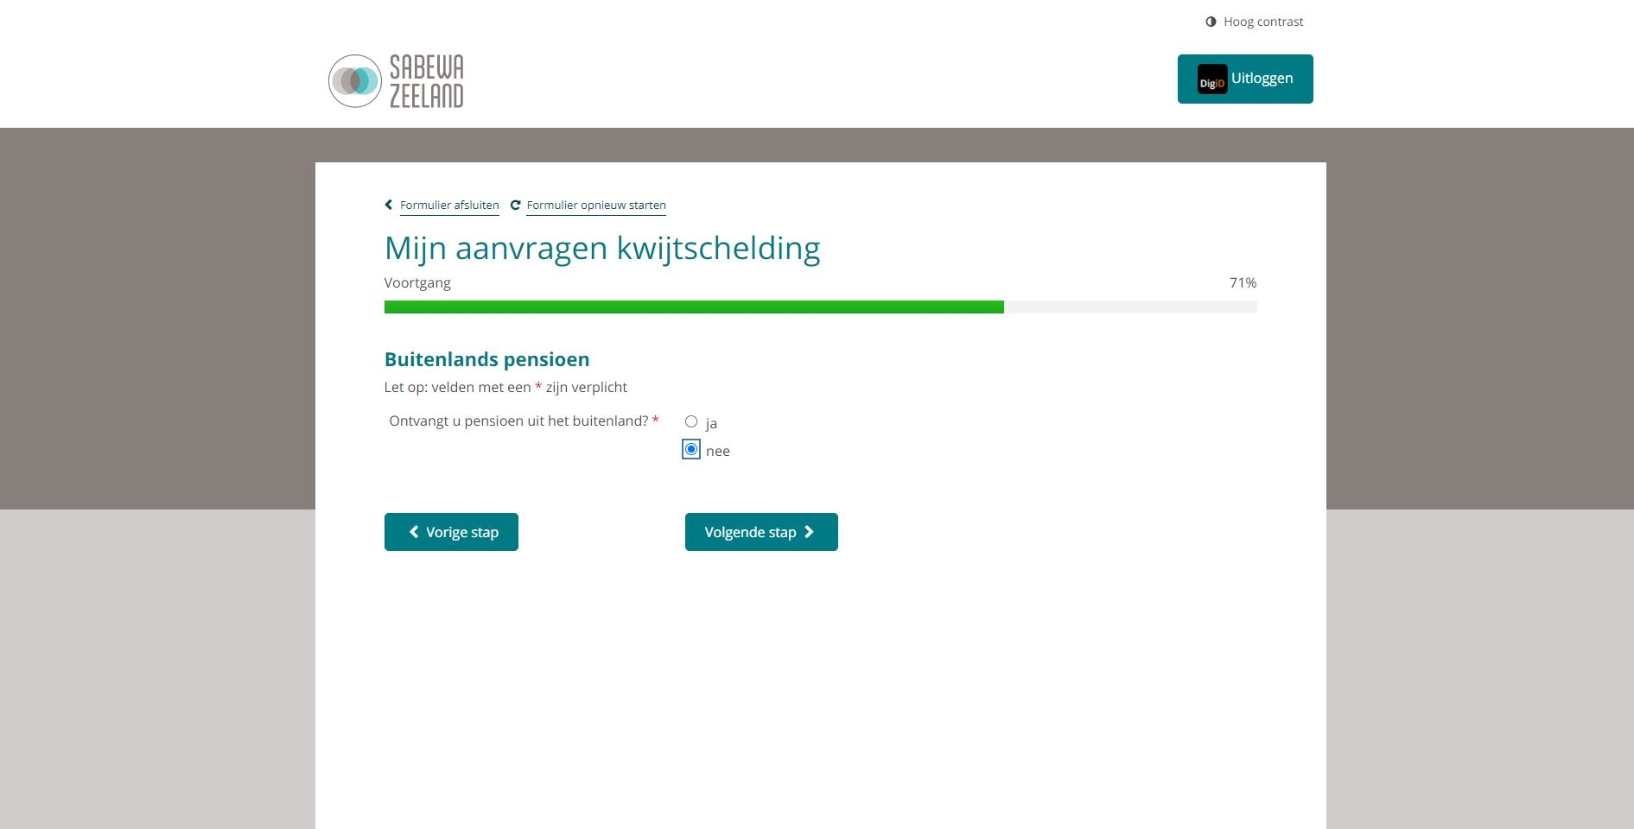
Step 18

Slide 29
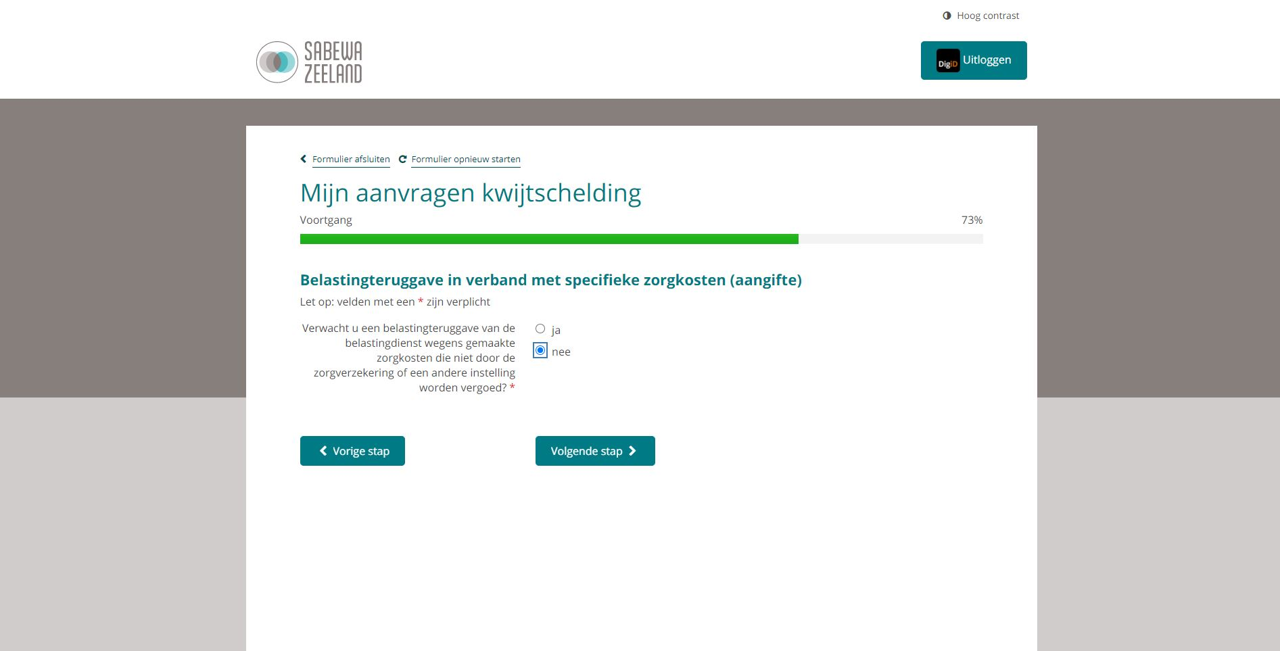
Step 19

Slide 30
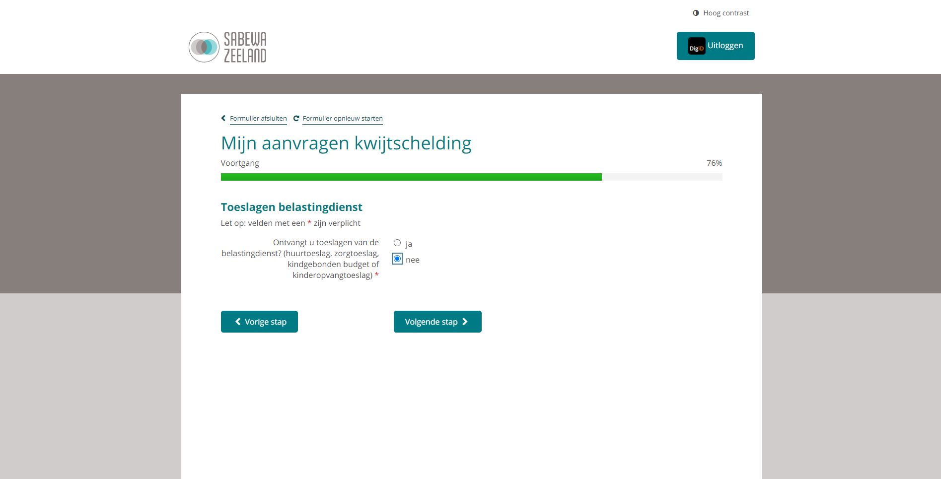
Step 20: Subsidies (housing and/or health)
Select Nee in case you do not receive any subsidies from the tax authorities (Belastingidesnts). Select Ja otherwise (huurtoeslag and/or zorgtoeslag).
Proceed with this guide HERE if you do not receive subsidies. Otherwise just go to next slide.

Slide 31
Step 20 (Plus):
In case you receive housing subsidy, select Ja and upload a screenshot from the site of Belastingdienst in the next step.

Slide 32
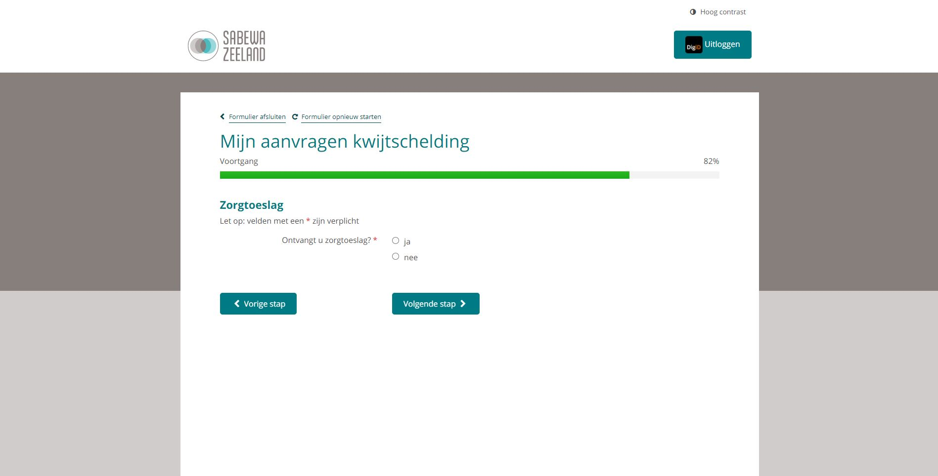
Step 20 (Plus)
In case you receive health insurance subsidy, select Ja and upload a screenshot from the site of Belastingdienst in the next step.

Slide 33
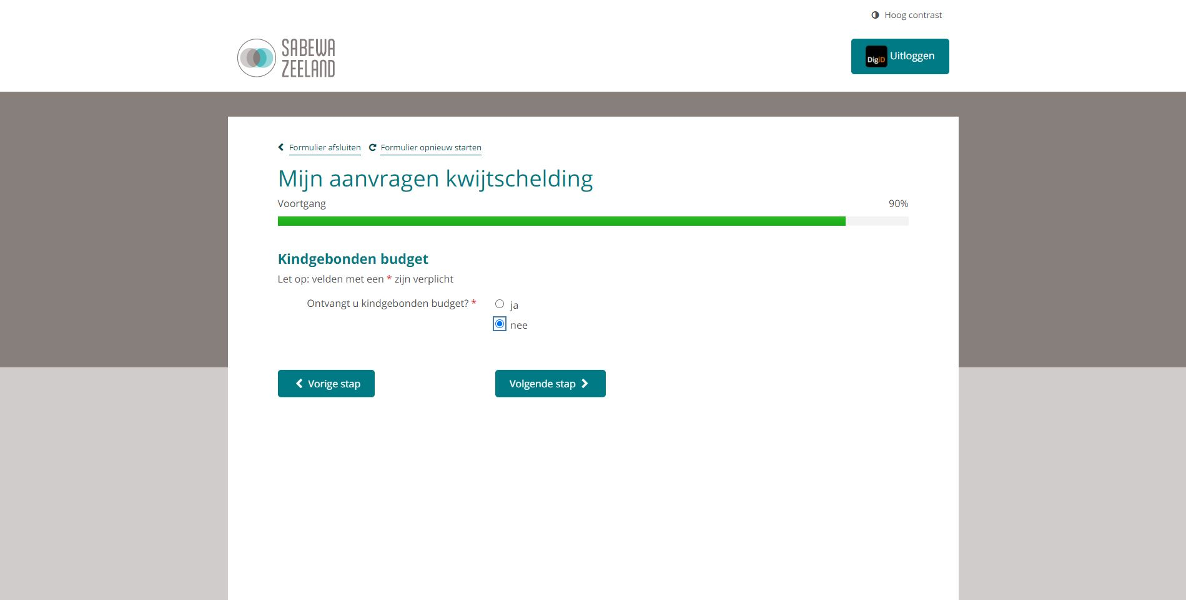
Step 21

Slide 34
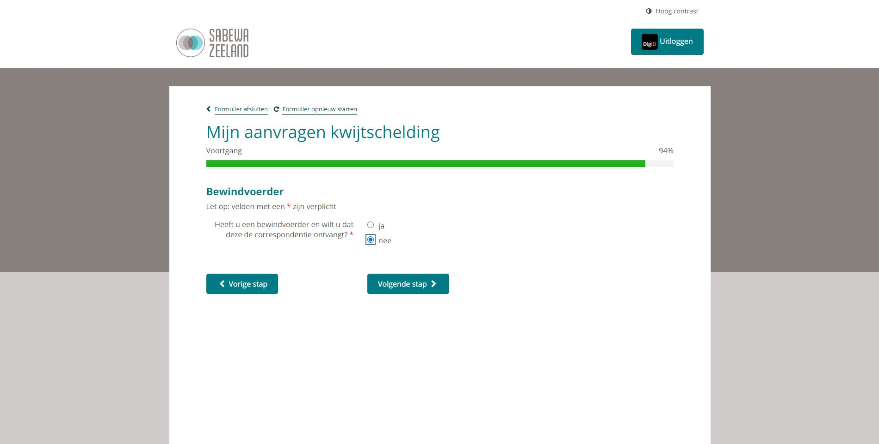
Step 22

Slide 35
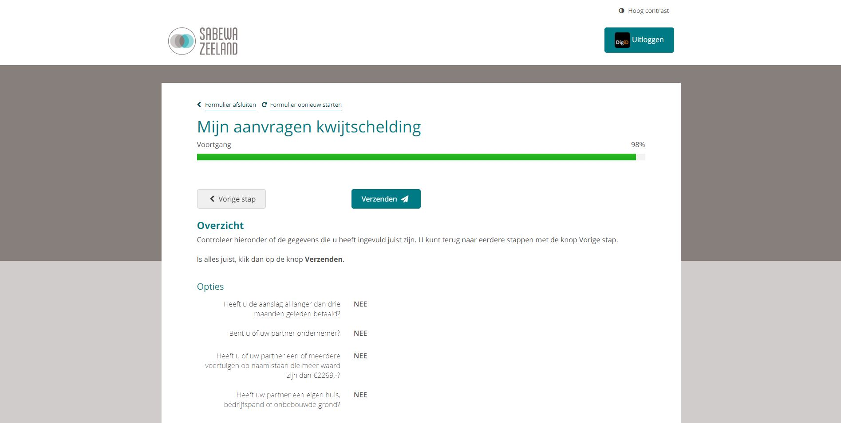
Step 23: Confirm and send

Slide 36
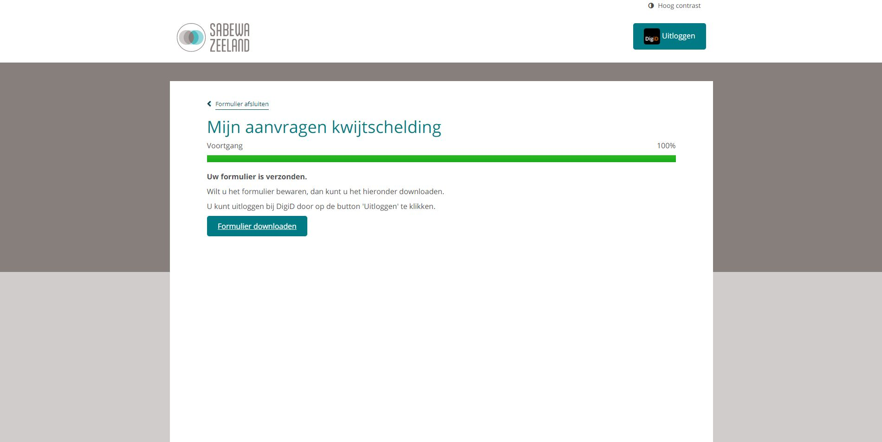
Done! Download your confirmation.
Download this form and save it in case needed in future.

Slide 37
THANKS!
Any questions?
You can find me at:
info@apvhousing.nl
WhatsApp

