Slide 1


APV
Accommodation and more!
Housing
Allowance

Slide 2
Index
What is the housing subsidy?
Who can obtain housing subsidy?
Prerequisites for application.
Procedure with screenshots.

Slide 3
What is the housing subsidy?
The housing subsidy (huurtoeslag) is a financial aid granted by the Dutch tax authorities.
The amount varies every year and it also depends from the bare rent of your studio/apartment.
It is a grant, and as long as you match the pre-requisites you will not be asked to pay it back.

Slide 4
Prerequisites for requesting housing subsidy
You must have completed the address registration process at your city hall.
You must have an active DigID account. https://www.digid.nl/en/apply-or-activate-digid
You must be 18 or older
Your annual work related income should not be higher than c.a. €16.000
Your housing must be a studio or apartment (independent front door and house number. Private kitchen, shower and toilet.

Slide 5
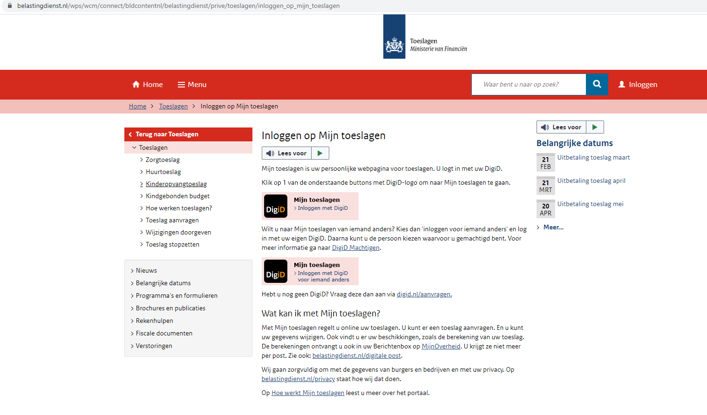
Step 1: Log in
https://www.belastingdienst.nl/wps/wcm/connect/bldcontentnl/belastingdienst/prive/toeslagen/inloggen_op_mijn_toeslagen

Slide 6
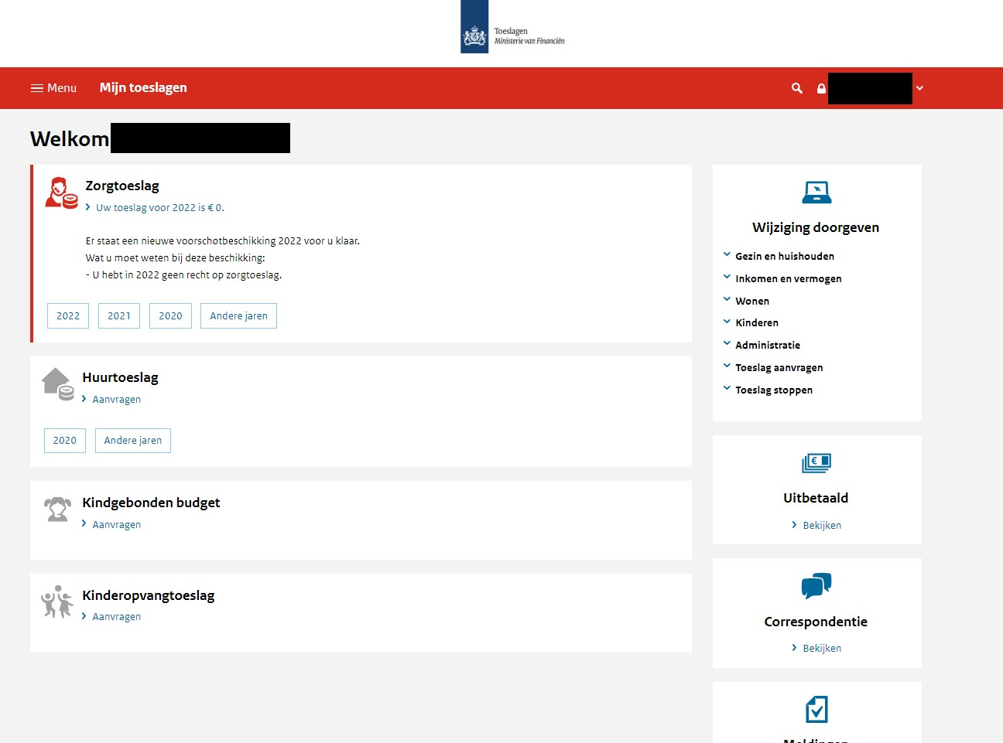
Step 2
Select

Slide 7
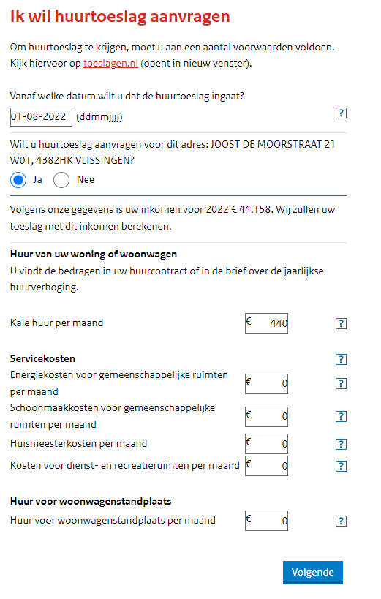
Step 3: Fill up your data
Fill in the date of your address registration. (Date when you registered onto the address at city hall)
Double check the address! If it is not correct – your address registration might not have been processed yet.
Fill in your BARE rent as indicated in your contract. Should be set at €450
Set remainder of amounts at € 0,-

Slide 8
Step 4
If it is the first time that you are applying for a subsidy from the Dutch tax authorities you will be asked to fill in your bank IBAN.
Please note this bank account must be on your name!
PS: we advise you to open a Dutch bank account and use this one for the subsidy application. This would result in a faster approval of your subsidy application.

Slide 9
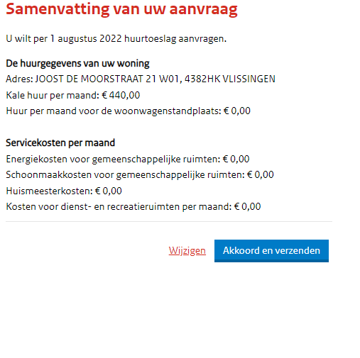
Step 5
Check your information and finalize!

Slide 10
Its done!
The application takes 5 to 8 weeks to process.
Once processed, you will start seing the amounts deposited on your bank account on a monthly basis.

Slide 11

THANKS!
Any questions?
You can find us at:
info@apvhousing.nl

